Slide 1
Simulating high throughput data with FBA
Lots of high throughput data out there! Broad parallel screens are a new part of biological experimentation.
I’ll show off two types of high throughput screens you can model with FBA, using small toy examples:
Library knockout screens
  Metabolic capability is varied
  Culture media remains the same
Nutrient utilization screens
  Metabolic capability remains the same
  Culture media is varied

Slide 2
Gene library knockout screens
You can easily test the effect of a set of gene knockouts on your model with FBA.
Construct a model (optional)
  We’ll cheat, and use EcoCyc
Identify the KB frame IDs of the knocked-out genes
Edit the .fba file appropriately
  Decide whether you want to produce individual knockout flux summaries (can be lots of data)
Run the simulation
Compare the results with what you expect

Slide 3
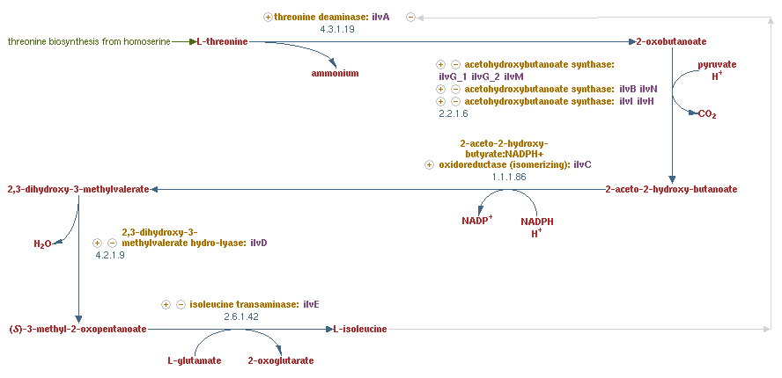
Knockout example: isoleucine synthesis

Slide 4
Knockout example: isoleucine synthesis
Build the gene KO list
Identify the KB frame IDs of the knocked-out genes
Find experimental data (Baba et al. glucose minimal)
Edit the .fba file appropriately
Run the simulation and compare
Gene | Frame ID | Exp Essential? | Sim Essential?
ilvA | EG10493 | Yes
ilvB | EG10494 | No
ilvN | EG10502 | No
ilvI | EG10500 | No
ilvH | EG10499 | No
ilvC | EG10495 | Yes
ilvD | EG10496 | Yes
ilvE | EG10497 | Yes

Slide 5
Knockout example: isoleucine synthesis
Build the gene KO list
Identify the KB frame IDs of the knocked-out genes
Find experimental data (Baba et al. glucose minimal)
Edit the .fba file appropriately
Run the simulation and compare
Gene | Frame ID | Exp Essential? | Sim Essential?
ilvA | EG10493 | Yes | No
ilvB | EG10494 | No | No
ilvN | EG10502 | No | No
ilvI | EG10500 | No | No
ilvH | EG10499 | No | No
ilvC | EG10495 | Yes | Yes
ilvD | EG10496 | Yes | Yes
ilvE | EG10497 | Yes | Yes

Slide 6

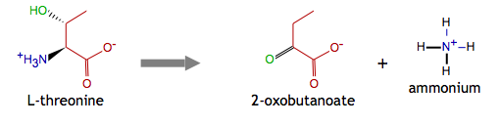
Knockout example: isoleucine synthesis

Slide 7
Nutrient utilization screens
FBA is also a great way to test whether your model will grow on different types of growth media.
Construct a model (optional)
  We’ll cheat, and use EcoCyc
Identify the KB frame IDs of the nutrients you want
Create appropriate .fba files
Run the simulations
Compare the results with what you expect

Slide 8
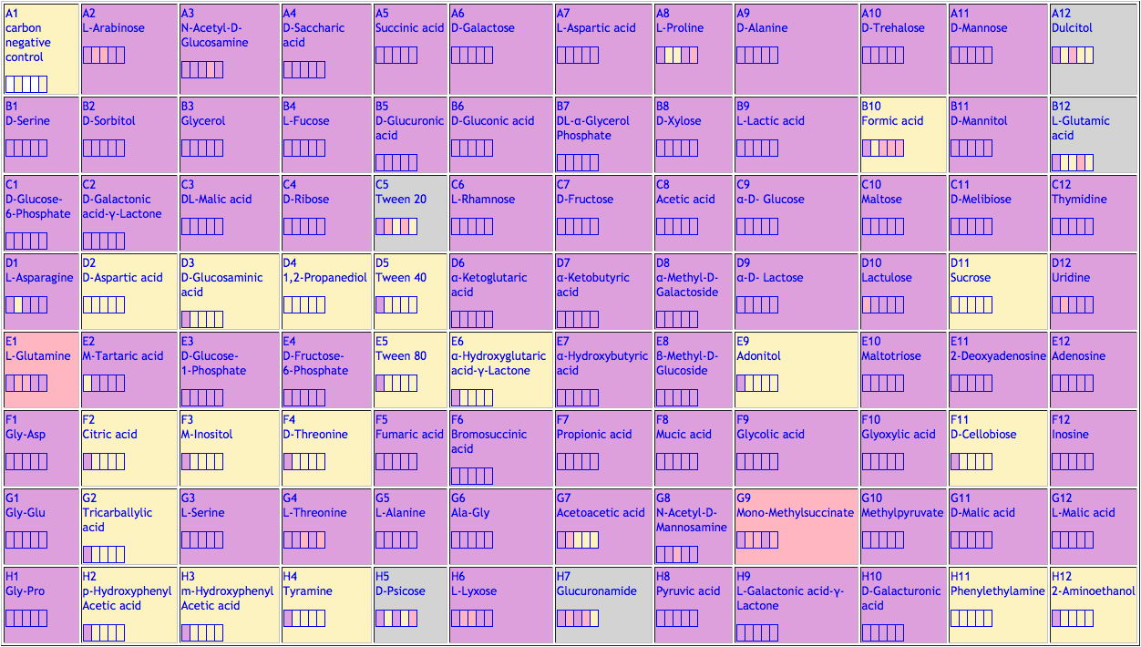
Nutrient utilization screens
Biolog carbon plate PM-1

Slide 9
Nutrient source example: Biolog PM-1 Col. 3
Build .fba files for each medium of interest
Find experimental data (EcoCyc data)
Run the simulation and compare
Carbon src. | Frame ID | Exp Growth? | Sim Growth?
NAcGlu | MIX0-421 | Yes
Glycerol | MIX0-433 | Yes
DL-malate | MIX0-445 | Yes
D-glucosaminate | MIX0-456 | No
D-glucose-1-P | MIX0-466 | Yes
Myo-inositol | MIX0-473 | No
L-serine | MIX0-484 | Yes
3-hydroxy-phenylacetate | MIX0-495 | No

Slide 10
Nutrient source example: Biolog PM-1 Col. 3
Build .fba files for each medium of interest
Find experimental data (EcoCyc data)
Run the simulation and compare
Carbon src. | Frame ID | Exp Growth? | Sim Growth?
NAcGlu | MIX0-421 | Yes | Yes
Glycerol | MIX0-433 | Yes | Yes
DL-malate | MIX0-445 | Yes | Yes
D-glucosaminate | MIX0-456 | No | No
D-glucose-1-P | MIX0-466 | Yes | No
Myo-inositol | MIX0-473 | No | No
L-serine | MIX0-484 | Yes | Yes
3-hydroxy-phenylacetate | MIX0-495 | No | No

