Slide 1
Tutorial: Overviews and Omics Viewers

Slide 2
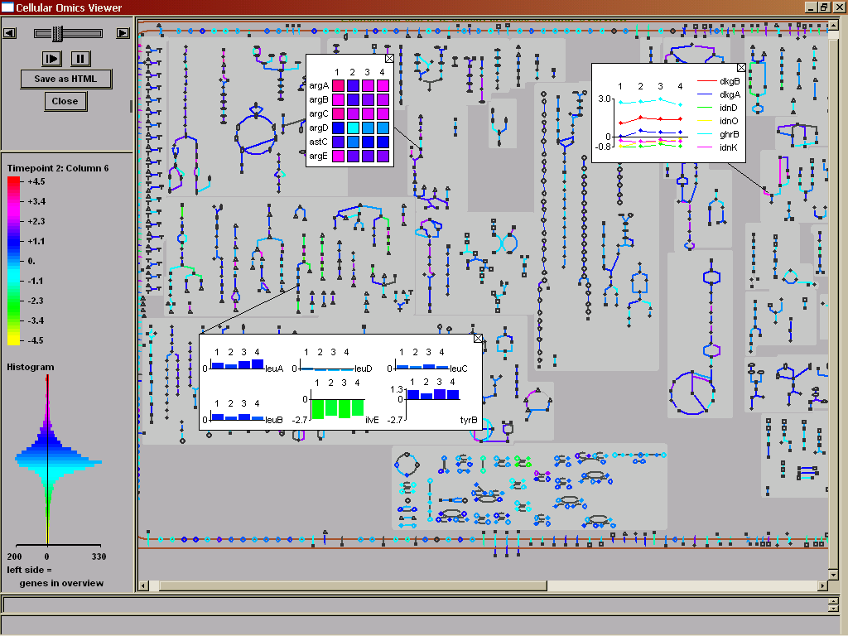
Introduction
Each overview is a system-level diagram of a different aspect of the cellular machinery
  Cellular Overview: metabolic and transport
  Regulatory Overview: regulation
  Genome Overview: genome
Overviews painted with omics data become omics viewers

Slide 3
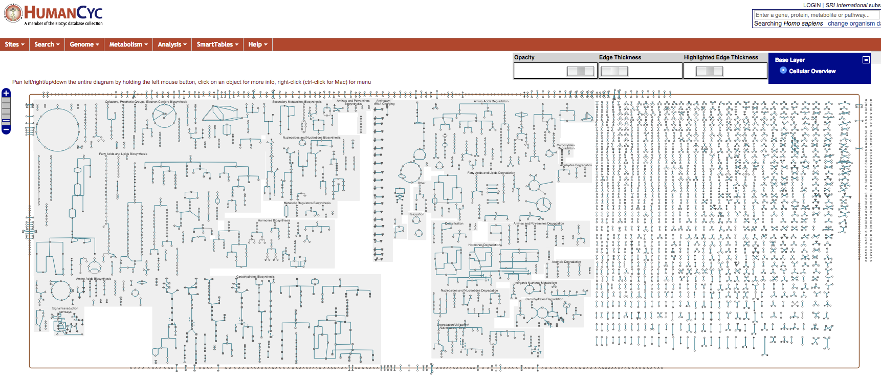
Cellular Overview Diagram
Combines metabolic map and transporters
Automatically generated, organism-specific
Zoomable, queryable

Slide 4
Organization of the Cellular Overview
Organism specific, generated by Pathway Tools
Lines are reactions, nodes are biochemical species (compounds, proteins)
Legend explains symbols used
Pathways grouped functionally
  Anabolism left, catabolism right, energy in the middle
  Gray backgrounds indicate more specific functional groups
  Non-pathway reactions on far right
Generally, pathways flow downward
Transport reactions and proteins shown on surrounding membrane
Periplasmic and extracellular reactions, proteins on far right, outside membrane

Slide 5
Physical Location in the Overview
Non-cytoplasmic proteins with known locations shown
  In E. coli, that means periplasmic, cell and outer membrane
  This includes proteins with no associated reaction
Desktop:
  Overview>Show/Hide Transport Links

Slide 6
Mouse-Over in the CellOv
Mousing over gray background identifies pathway class
Mousing over a node gives compound name and pathway
Mousing over a line gives reaction information
Can click through from anything to the PGDB

Slide 7
Zooming and Panning
Web mode:
  Hold mouse and drag to pan
  Click ladder at upper left, or double-click to zoom
Desktop: right-click to
  Zoom
  Pop up pathways
  Highlight
  Indicate pathway connections (clear in overview menu)
  More

Slide 8
Highlighting in the Overview Desktop Mode
Overview>Highlight>many options
  Pathway by class (biosynthesis > all > select all)
  Reactions > All without EC numbers (note second color)
    Note all reaction options (many!)
  Reactions > By modulation
Can clear highlighting at any time
Can save highlighting to file for later use
Can do Genes and Compounds as well
Can pull information from a file, or from answer list

Slide 9
Highlighting in the Overview Web Mode
Highlight cmds in right-sidebar
Clear/enable individual highlights using switching panel at upper right
Can save highlighting to file or URL for later use
  Right -> Generate Bookmark for Current Cellular Overview
Multiple highlight
  Highlight/Omics View Based on Names and Frame IDs

Slide 10
Highlighting to Compare Organisms Desktop Mode
Look at shared or nonshared reactions
Example – E. coli reactions shared with humans
Example – switch to a second organism
  Reactions not shared with (human and coli)
  Set from Any to All
  One way to think about drug targeting, e.g.
Quick note – cross-species comparison from pathways
  Go to this from individual pathway pages
  Compares presence of pathway in question, and reactions of that pathway

Slide 11
Genome Overview Diagram
Shows genes schematically, not to scale (unlike Genome Browser)
Shows transcription units and direction of transcription
Shows protein versus RNA coding status
Mouse over for gene name, product, pathway participation, and intergenic spacing
Supports substring search
To enter (desktop mode):
  Overviews > Show Genome Overview
  Genome Browser: Click level 4 (Genome)
To enter (web mode):
  Genome > Genome Overview
  Genome Browser: Click level 4 (Genome)

Slide 12
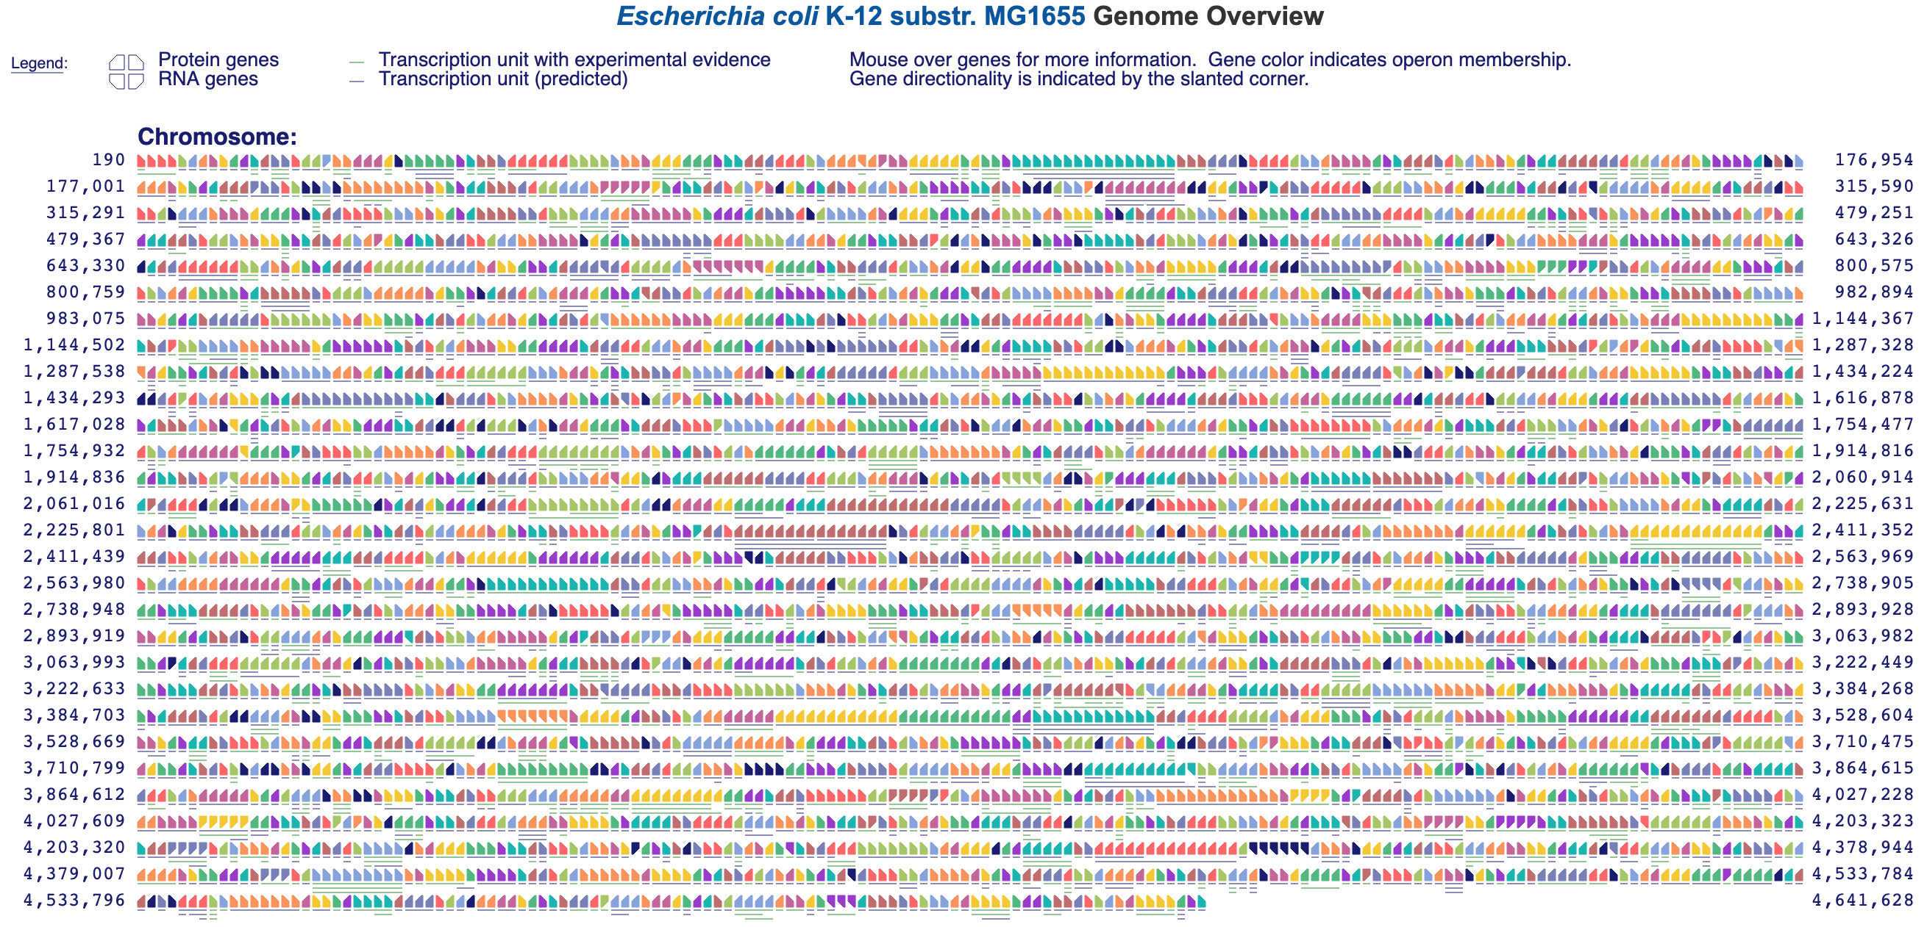
Genome Overview Diagram

Slide 13
Regulatory Overview
Displays regulatory network for an organism
Regulatory relationships must curated or loaded from an external database
Rings show regulatory status
  Inner – global regulators
  Middle – other regulators
  Outer – genes that are regulated only
Desktop: Overviews > Show Regulatory Overview
Web: Genome > Regulatory Overview

Slide 14
Exploring Regulatory Relationships
Pick a gene and right-click on it to see highlighting options
Can show direct and indirect regulators and regulatees
Display options available in the menu
  Change layout
  Display highlighted genes only
  Zoom and pan

Slide 15
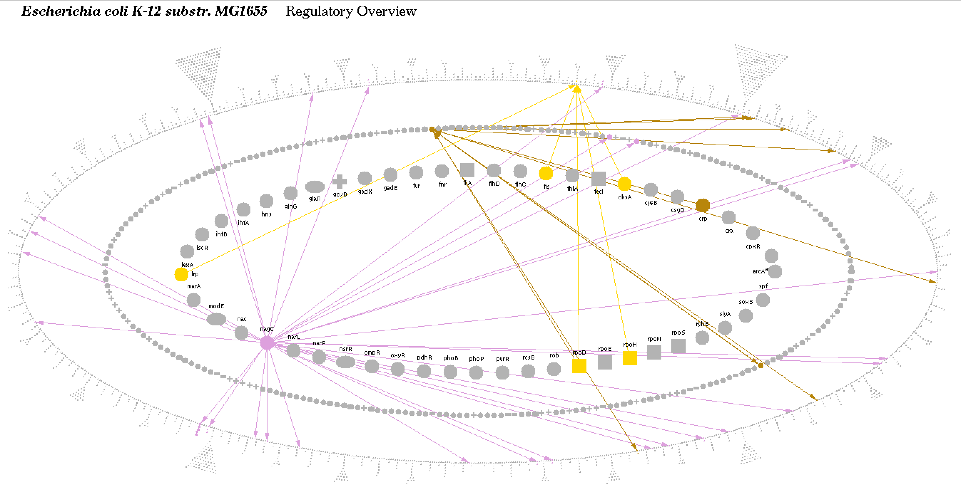

Slide 16
Omics Viewers

Slide 17
Metabolomics Applications
MetaCyc contains extensive multi-organism metabolite database (13,000)
Organism-specific metabolite databases in each PGDB
  Genome+pathway context for interpreting metabolomics data
Search for monoisotopic mass + chemical formula
SmartTable management of metabolite sets
  Metabolite->pathway transformation
  Pathway enrichment analysis
  Pathway perturbation computation
Paint metabolomics data onto pathways
Metabolite translation service
  biocyc.org/web-services.shtml

Slide 18
Overview of Omics Data Analysis in BioCyc
Omics Viewers
  Cellular Overview, Regulatory Overview, Genome Overview
  Omics pop-ups
  Omics data on pathways, pathway collages
  Omics data on table of pathways
Omics Dashboard
Metabolomics
  Monoisotopic mass search (Search -> Compounds)
  Metabolite translation service
    http://biocyc.org/metabolite-translation-service.shtml
  Pathway Covering
Genome Browser tracks
SmartTables: enrichment analysis, other transformations

Slide 19
Overview of Omics Data Analysis in BioCyc
SmartTables
  Define sets of differentially regulated genes or metabolites
  Browse
  Share with colleagues
  Perform enrichment analysis
  Transform to operons
  Transform to significantly expressed pathways

Slide 20
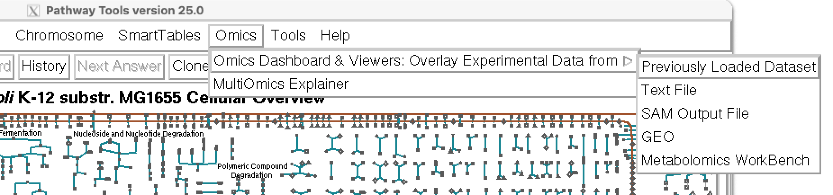
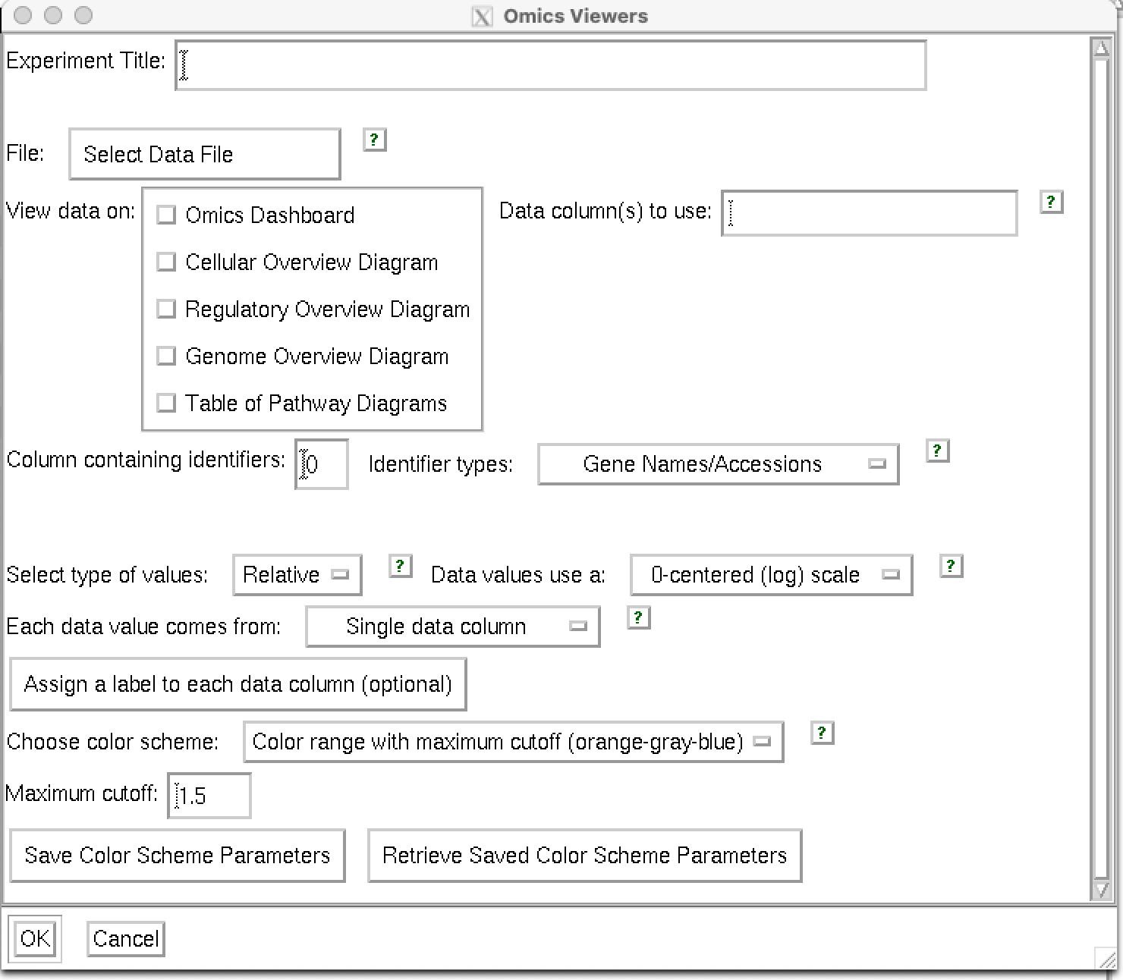
The Omics Viewers
Visualize any data that attaches numbers to genes, proteins or compounds
  Proteomics, metabolomics, genomics, combinations thereof
Data sources:
  Tab-delimited files
  Keyboard (web only)
  GEO – search by keyword (curated datasets only)
  Metabolomics Workbench (desktop only)
  SmartTable

Slide 21
Sample E. coli data files included in Pathway Tools Distribution
Directory: aic-export/pathway-tools/ptools/25.0/install/htdocs/expr-examples/
time-series.txt
  Chang et al, Mol Microbiol (2):289-306, 2002
  Time course showing diauxic shift from growth on glucose to growth on lactose
  Log ratios
ecoli-feuer-toaerobic-significant.txt
  Von Wulffen et al, Genes 8(3) 2017
  10 minute time course following shift from anaerobic to aerobic growth
  Normalized average RNA-seq read counts, significant genes only

Slide 22
Desktop vs Web Omics Viewers
Different graphical / interaction styles
 | Desktop | Web
Save/Restore State | ✔
Screen Grab | ✔ | ✔
Animate Multiple Time Points | ✔ | ✔
Save-as-HTML (video) | ✔
One dialog to all viewers | ✔
Genome Omics Viewer | ✔

Slide 23
Using the Omics Viewers
Data file format
  Tab separated columns
  One or more object names / IDs in column zero
    id1$name1$id2$name2$id3
    trpA
    trpA$b0383
    spermidine$KEGG:C00315$PubChem:6992097
  Columns can contain any numeric data
    Gene expression, proteomics, metabolomics, reaction fluxes
  Labels can be specified in first non-comment line:
    $T=0 T=20 T=40

Slide 24
Viewing Multiple Data Sets
Compare multiple data points using animation
Typically a time course, but does not have to be
Tell Pathway Tools which columns to use
Same output color / cutoff selections as single experiment
If you use automatic color scale, it’s set to the maximum shift in the experiment
  Thus, all time points / data sets comparable
  A good way to standardize across experiments
Can move between experiments/time points manually
Can save as HTML (desktop)

Slide 25
Omics Viewer Output
Data report
  Total data rows
  Data rows not shown
  Data rows with invalid data
  Color key
Display options
  Set maximum cutoff for default color scheme (e.g. 0.3)
  Set manual color cutoffs (e.g. 0.3, 0.6, 0.9)
  Both options let you compare different experiments

Slide 26
Omics Viewer Options
Relative vs absolute
  Absolute: Concentrations or molecule counts. Negative values are ignored.
  Relative: Ratios with or without log transform
0-centered vs 1-centered scale
  0-centered = log scale with positive and negative values
  1-centered = linear scale, centered on 1
    Ratios
    Negative values ignored

Slide 27
Omics Viewer Color Schemes
Full color spectrum from data
  Data from one file mapped to full color spectrum
  Different experiments will receive different color assignments
Full color spectrum with max cutoff
  User specifies cutoff
  Useful for comparing datasets
Three color display with threshold
  Three color bins: x < 1/T , 1/T < x < T, x > T
User-defined bins with computer colors
User-defined bins with user colors

Slide 28
Web Omics Viewer
Mouse-over for omics pop-ups
Right-click reaction or metabolite for omics-popup for pathway
To see omics data on individual pathway:
  Navigate to pathway page
  Sidebar > Customize or Overlay Omics Data on Pathway Diagram

Slide 29
Desktop Omics Viewer

Slide 30
Omics Data Graphing on Cellular Overview

Slide 31
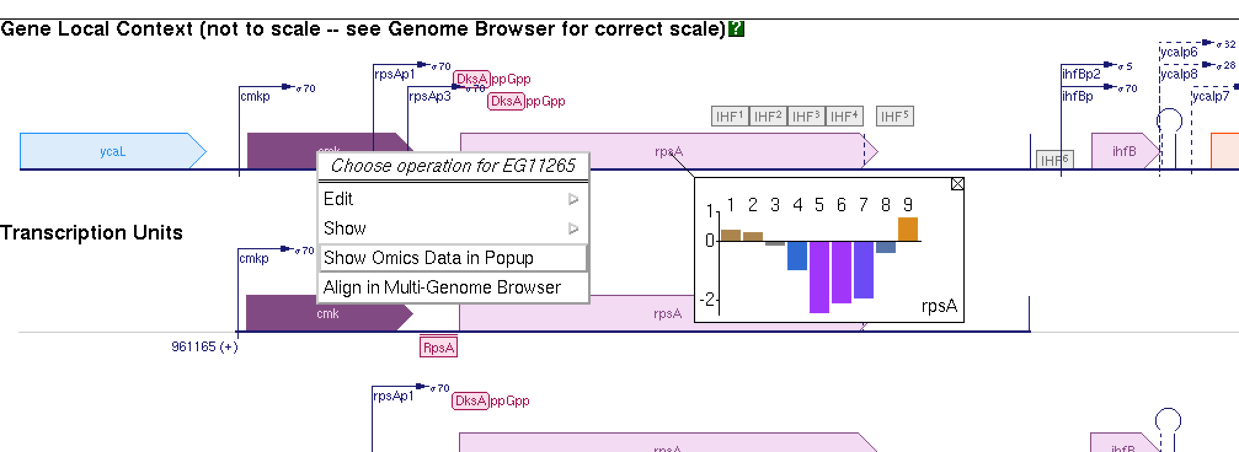
Omics Popups
The most recently loaded omics dataset becomes your “current dataset”
On any data page, right-click on any object to see its omics data.
Pathway pages have additional options
  Toggle popups for all reactions/metabolites via Omics Controls panel
  Import new dataset directly onto pathway

Slide 32
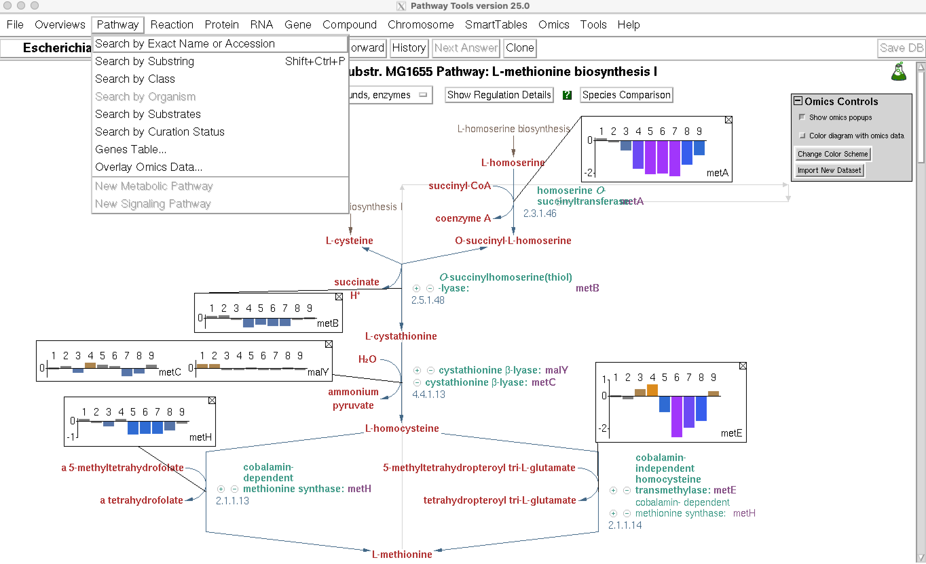
Omics Data on Pathway Pages

Slide 33
The Omics Dashboard

Slide 34
Omics Dashboard
Interactive tool for analysis of omics data
  Gene expression
  Proteomics
  Metabolomics
  Reaction fluxes
Use cases:
  Understand an omics dataset at multiple levels
  High-level survey of responses of many cellular systems
  Examine specific pathways, subsystems of interest in detail
  Visualization provides quick understanding of quantitative behavior
  Visually detect patterns missed by simple statistical filtering

Slide 35
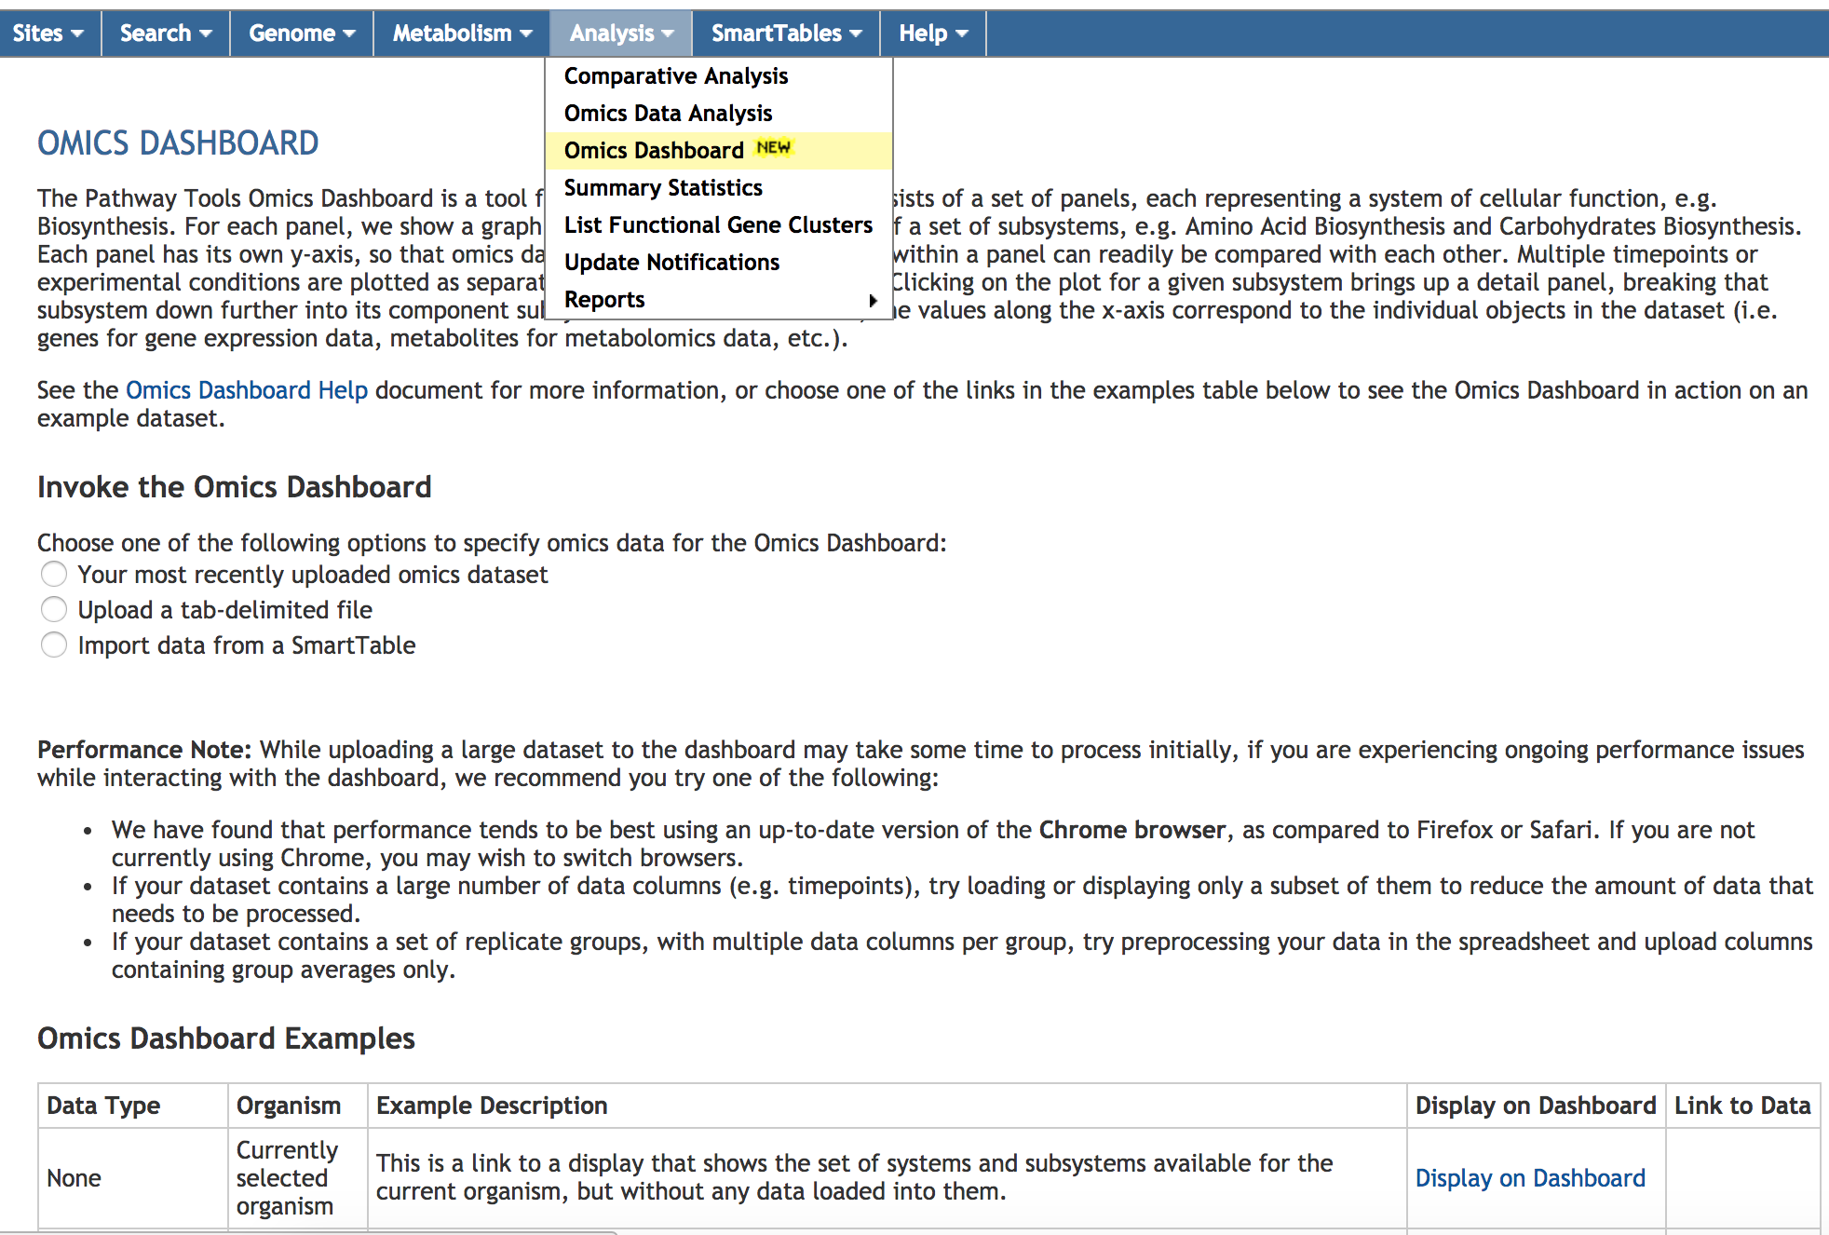
Accessing the Omics Dashboard

Slide 36
Sample Dataset
Escherichia coli transcriptomics data
  Von Wulffen et al Genes 8(3) 2017
10 minute time course following shift from anaerobic to aerobic growth
Normalized average RNA-seq read counts on Y-axis

Slide 37
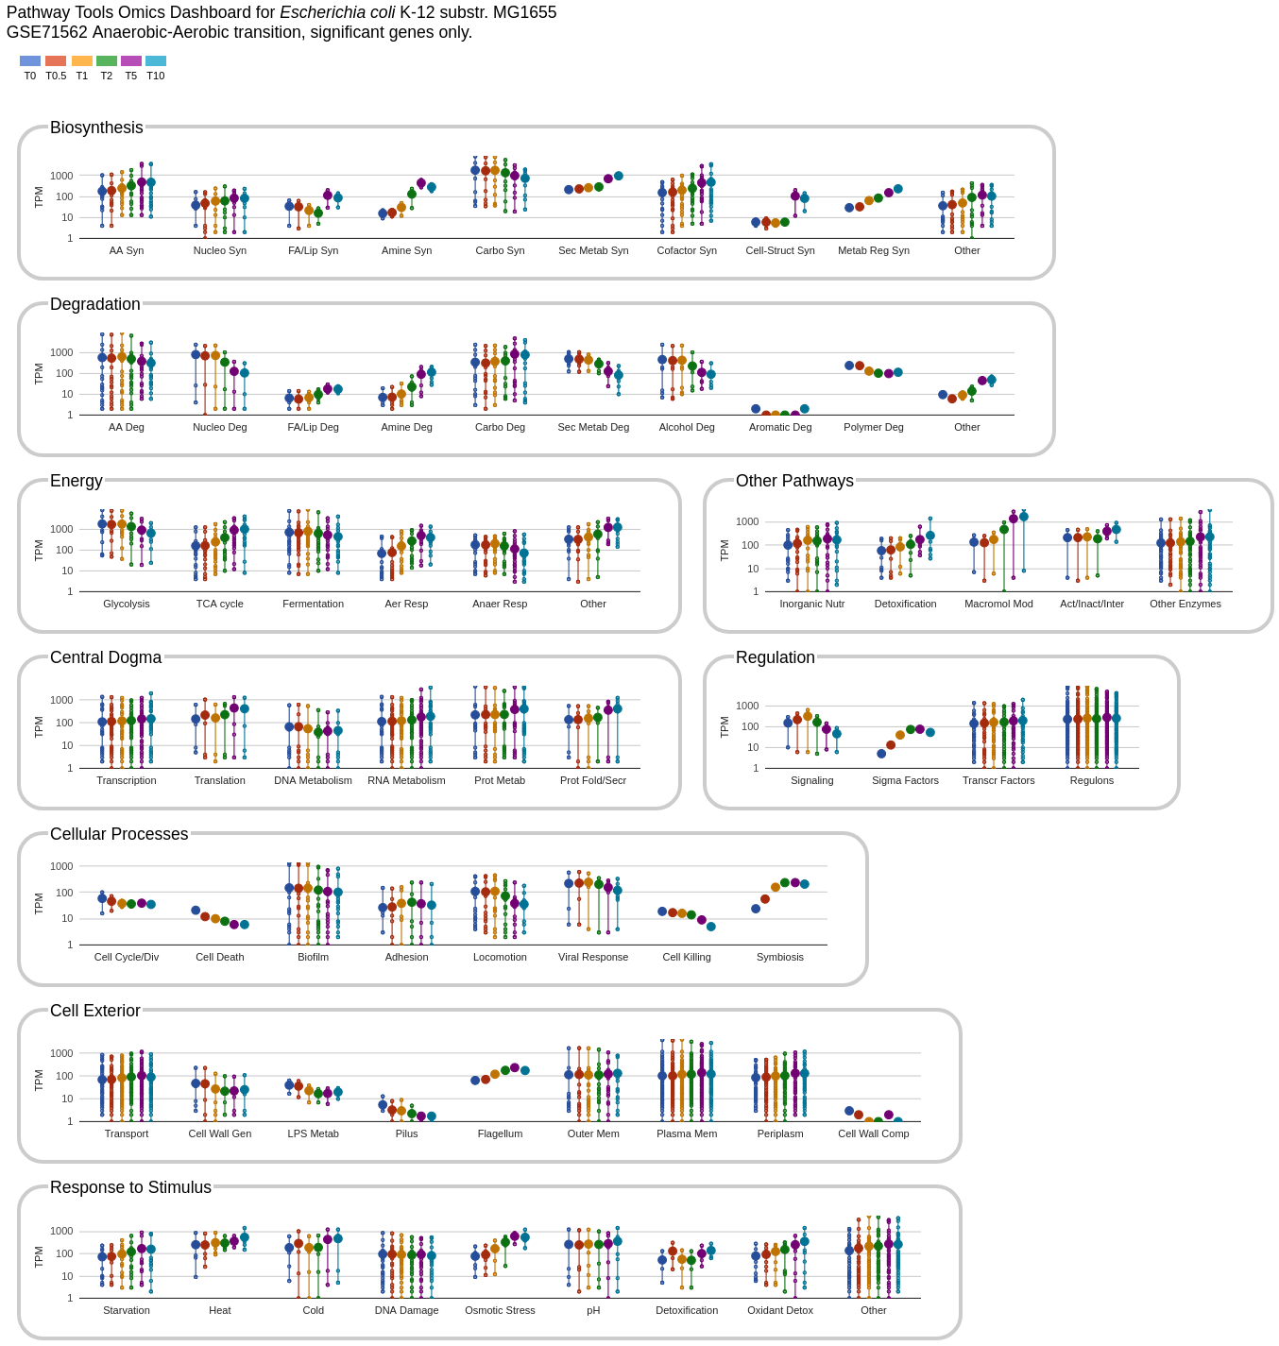
Organization of Omics Dashboard
A series of panels summarize omics data for different cellular systems
Each panel contains a set of plots (subsystems)
Implemented in JavaScript, using Google Charts
Notes:
Each point on a vertical line is a reading for one gene.
Set of metabolites on one vertical line are all genes in that subsystem for which data is available.
Large point is the average.

Slide 38
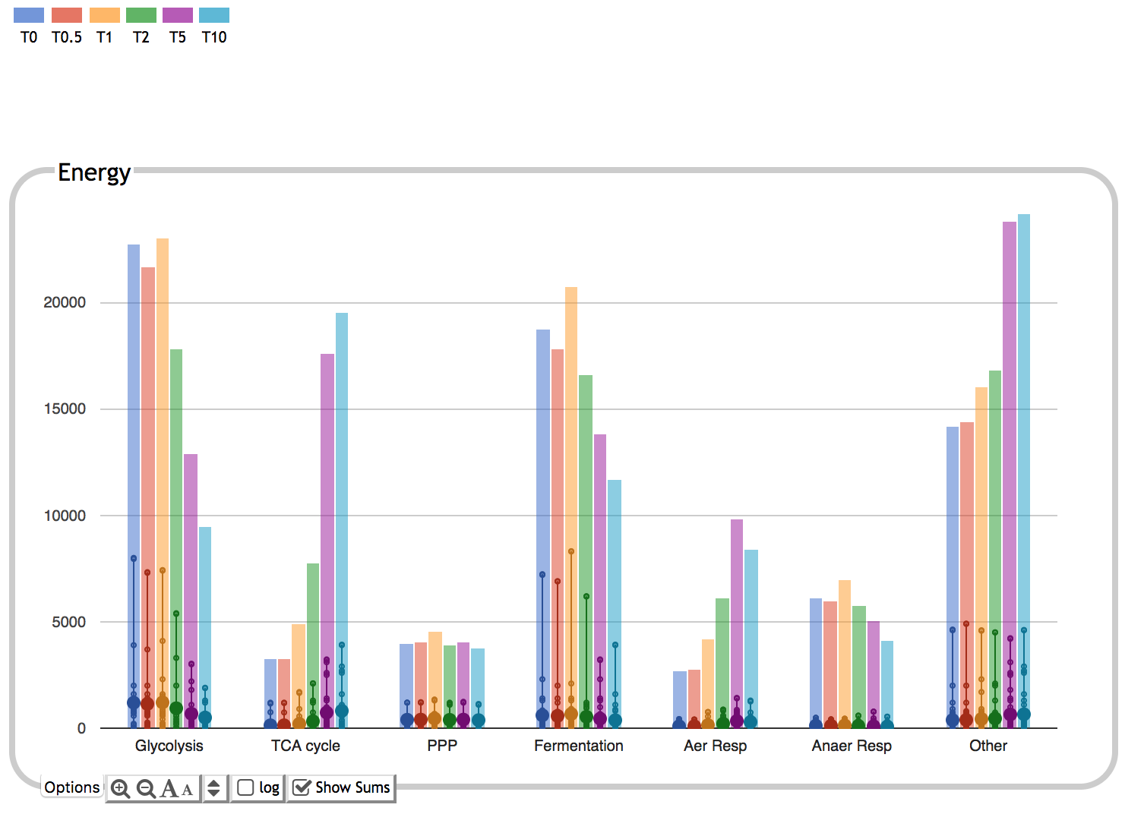
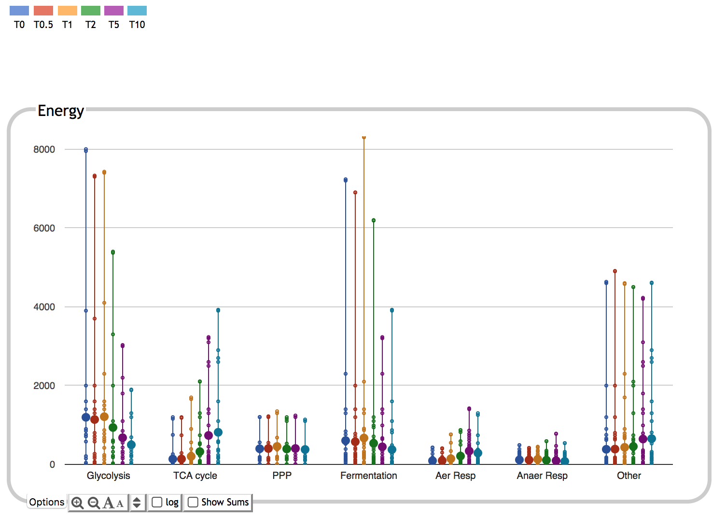
Colors correspond to timepoints
Bar height corresponds to sum of expression values for all genes in subsystem
Large dots show average over all genes in subsystem
Small dots correspond to individual gene expression values

Slide 39
Dashboard Systems and Subsystems
Derived from
  MetaCyc Pathway Ontology (355 classes, many individual pathways)
    E.g. Biosynthesis, Energy Metabolism, Cofactor Biosynthesis, TCA Cycle
  Gene Ontology terms (80 terms)
    Hand-curated subset, mostly Biological Process, some Cellular Component
    E.g. Response to Stimulus, Biofilm, Protein Folding, Outer Membrane Proteins
  Other
    Transporters, Regulons, Sigma Factors
Organism-specific
Dataset-specific
Users can add or remove plots from any panel
Users can create new subsystems from gene set, pathway set, GO term

Slide 40
Notes:
Four panels are metabolic, five panels are non-metabolic.

Slide 41
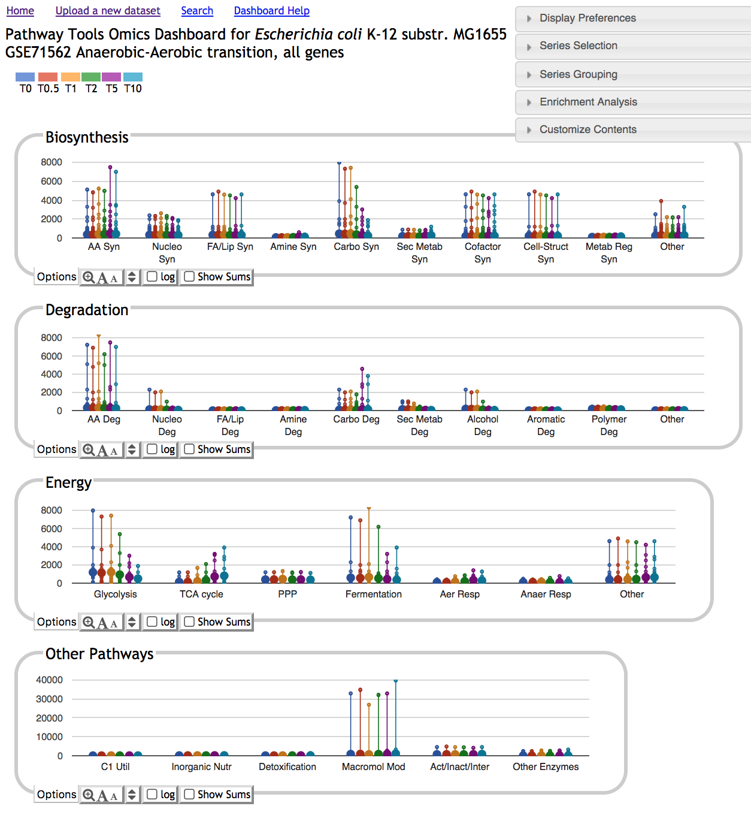
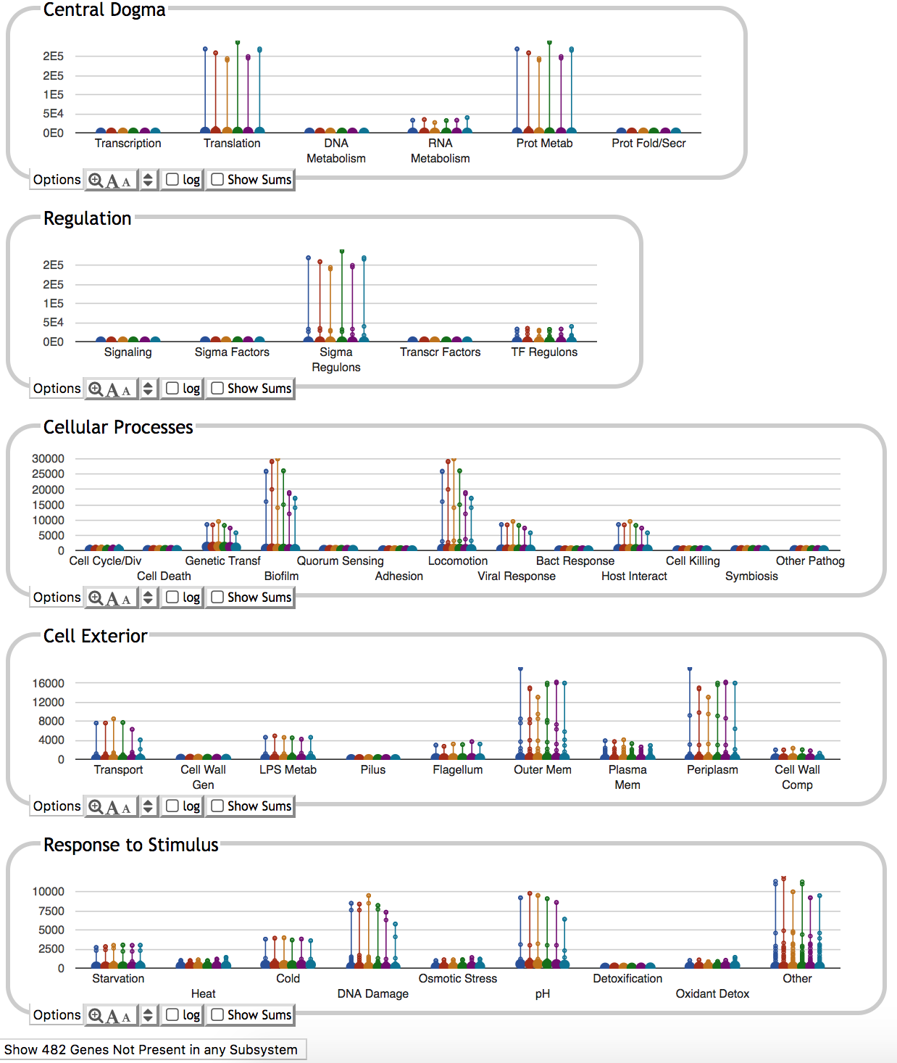
Dashboard Top Level Display

Slide 42
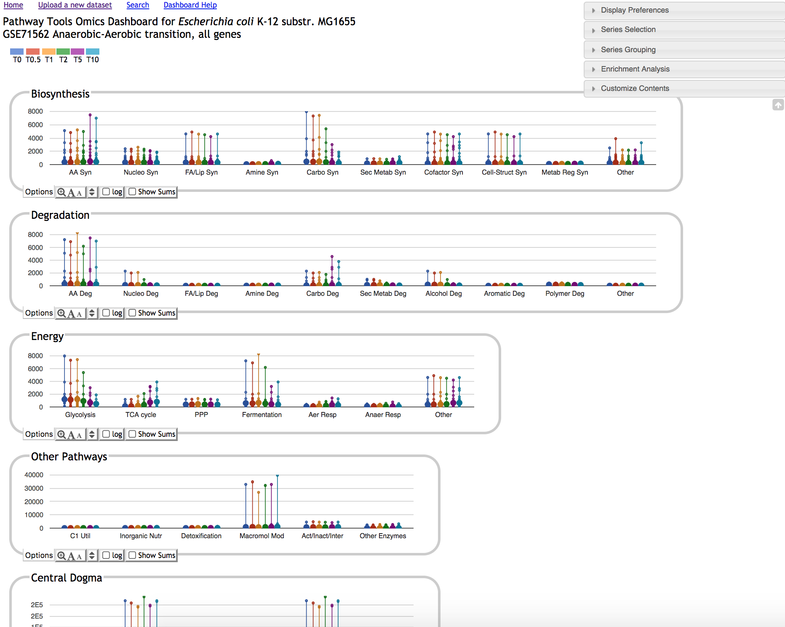
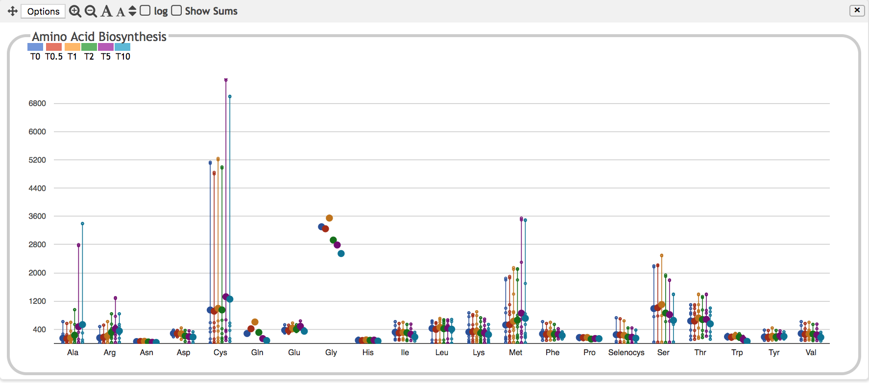
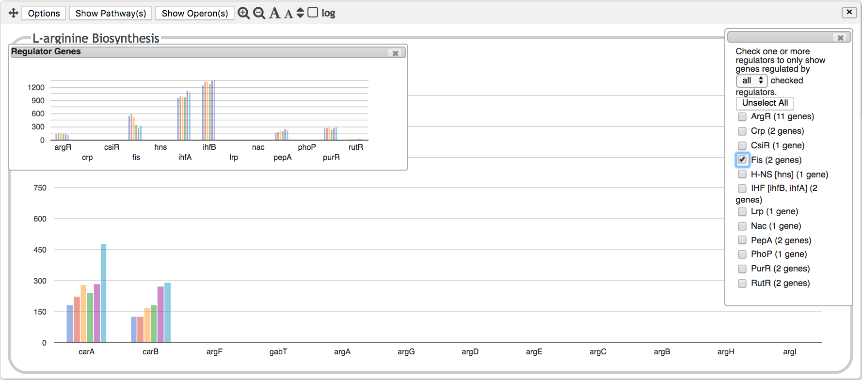
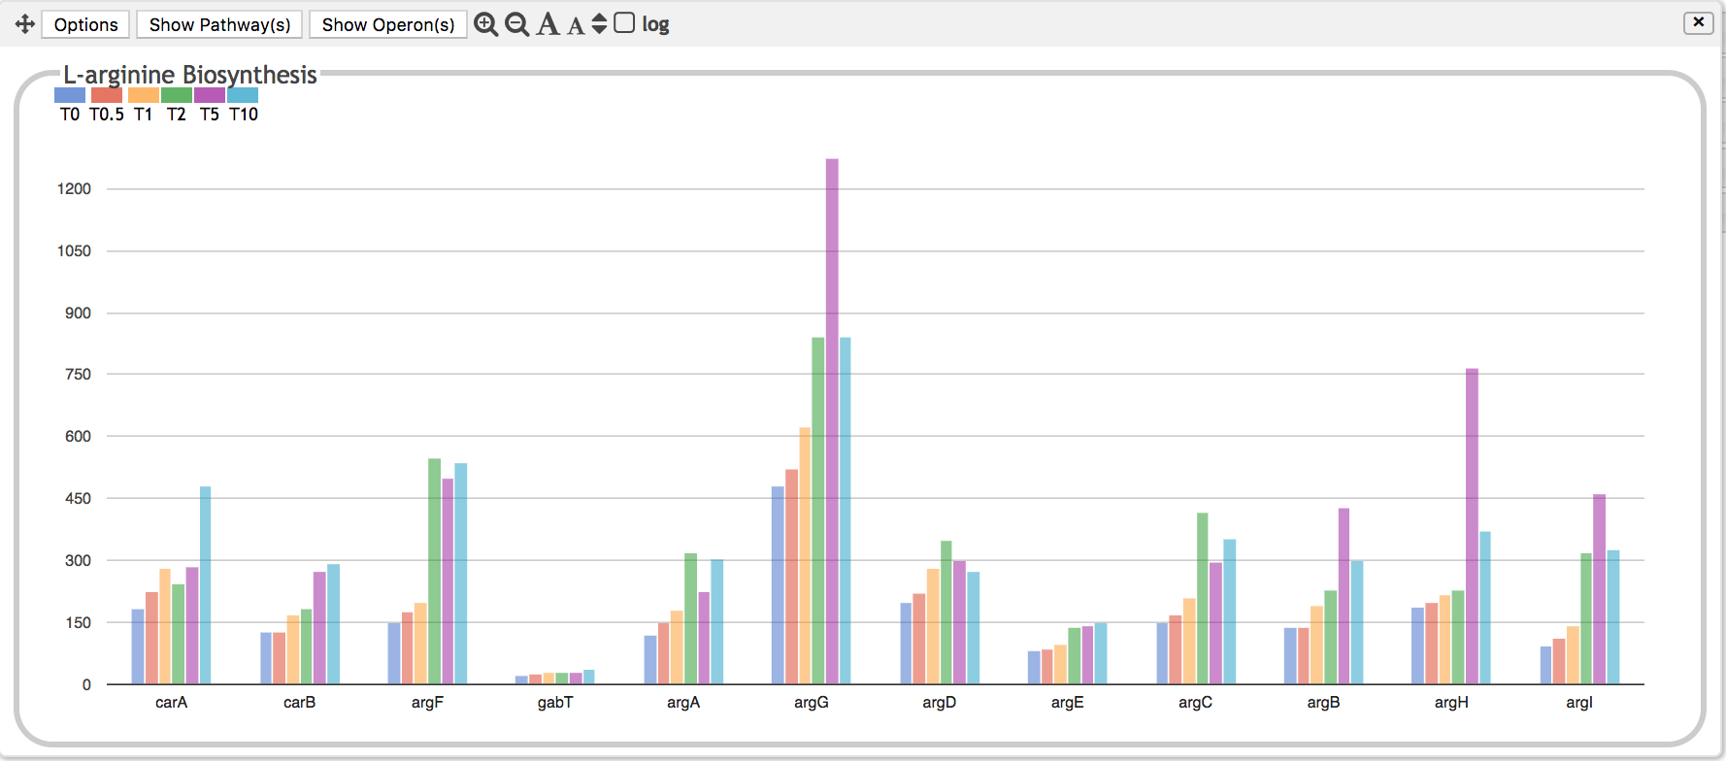
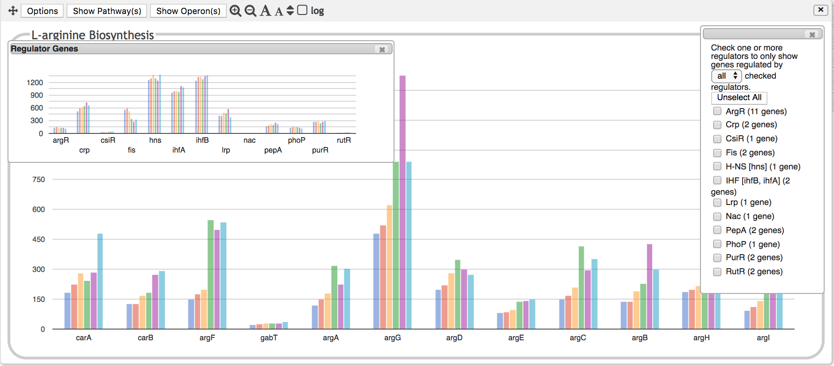
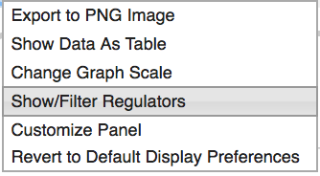
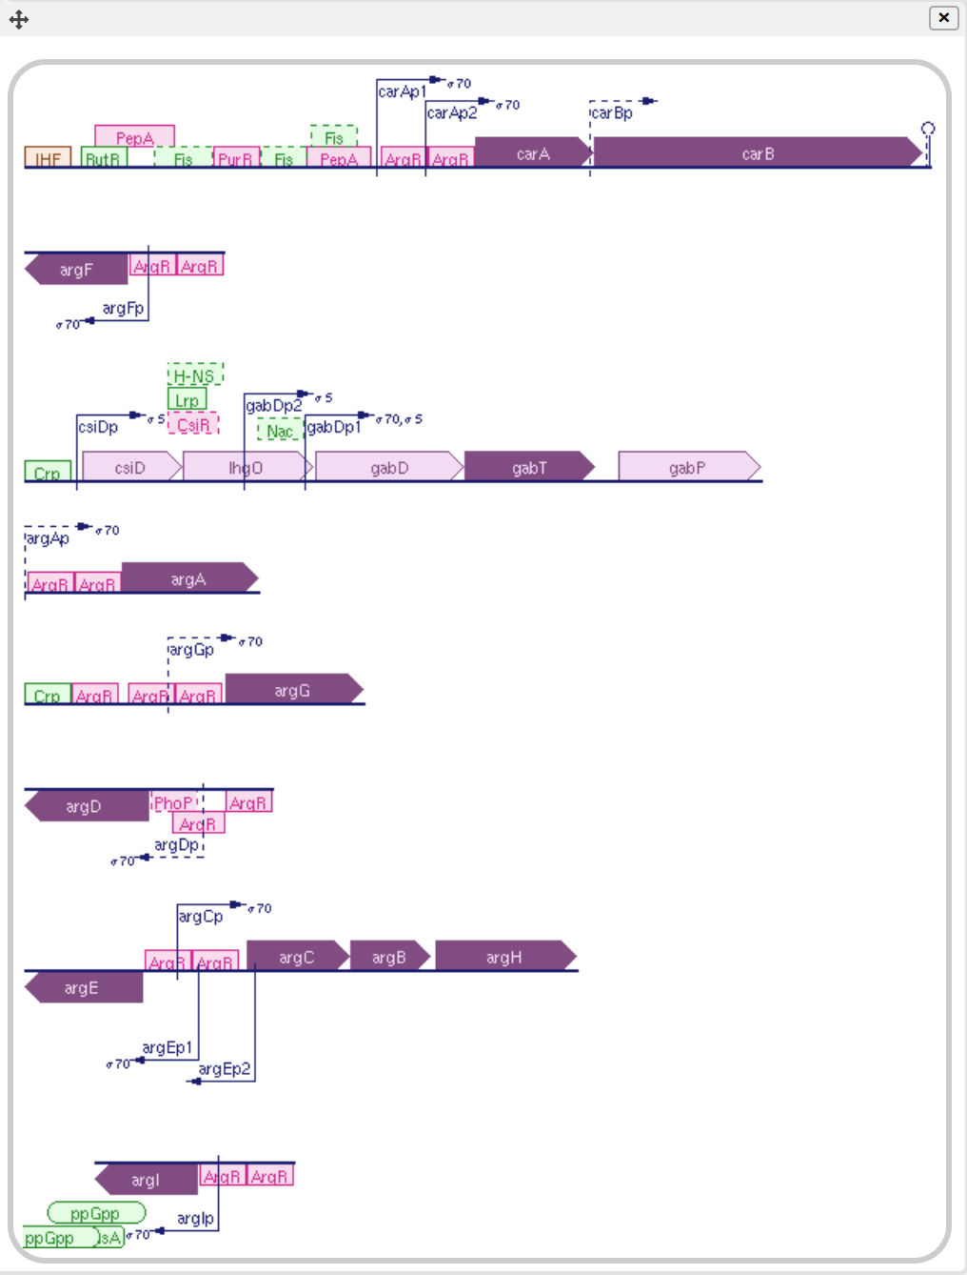
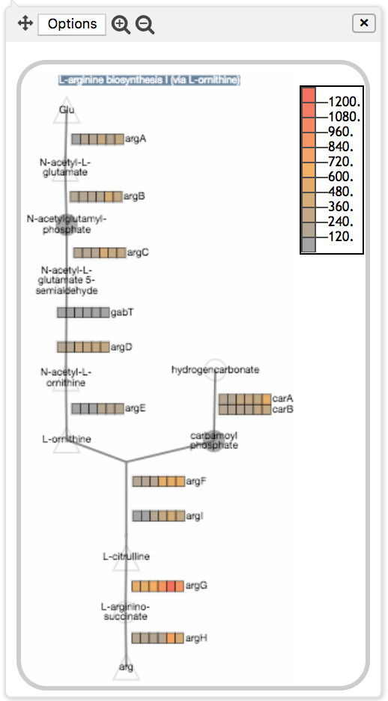

Slide 43
Other Capabilities
Choose log or linear scale
Customize panel size, vertical scale
Sort by gene position, alphabetical, data value
Select which data series to show/hide
Average data for multiple replicates
Perform enrichment analysis
Generate table of data for selected panel
Export to SmartTable

Slide 44
Using the Dashboard
Apply normalization and significance calculations before uploading data, if applicable.
Decide whether to average replicates before upload, or have dashboard do it for you (performance implications)
Import data as a column-delimited file
  Gene names/metabolite names/IDs in first column
  Specify which other columns contain data of interest
  Types of data values
    Fold change values
    Absolute quantities (counts, areas, intensities)
    P-values from replicate analysis (used for enrichment analysis)
Modify diagram scale as needed, choose log vs linear

Slide 45
Enrichment Analysis
Which systems have more perturbed genes than expected by chance?
User specifies
  A p-value column associated with each timepoint
  Threshold (0.05 in this example)
  Multiple hypothesis correction function
Compute enrichment score for every system, subsystem
  Fisher-exact hypergeometric test
  Enrichment score for a system = -log₁₀(p-value)
Panels show
  Enrichment scores for each system
  Highest component subsystem score

Slide 46
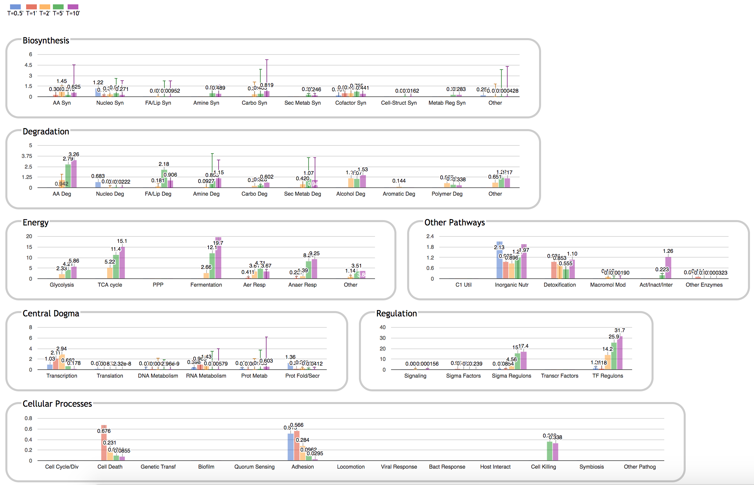
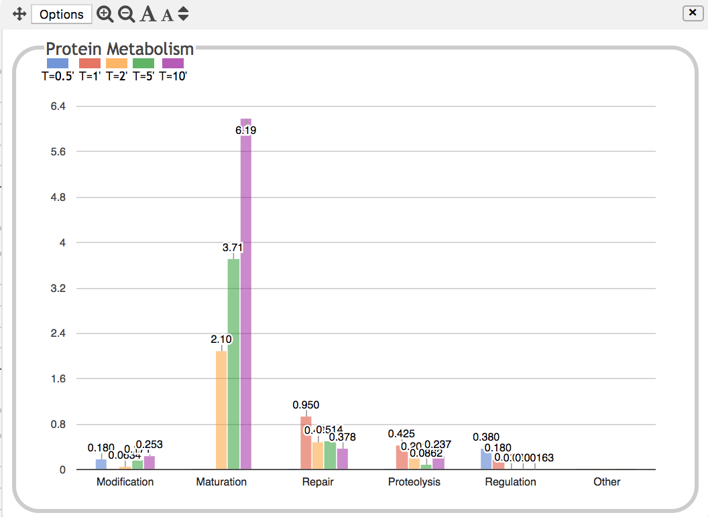

Slide 47
Pathway Collages

Slide 48
What is a Pathway Collage?
Web Application (but accessible from both web and desktop PTools)
User-specified set of Pathway Diagrams
Zoomable, Editable, Customizable
Generate High-Quality Images for Publications and Presentations
Overlay Omics Data
Implemented in JavaScript using Cytoscape.js

Slide 49
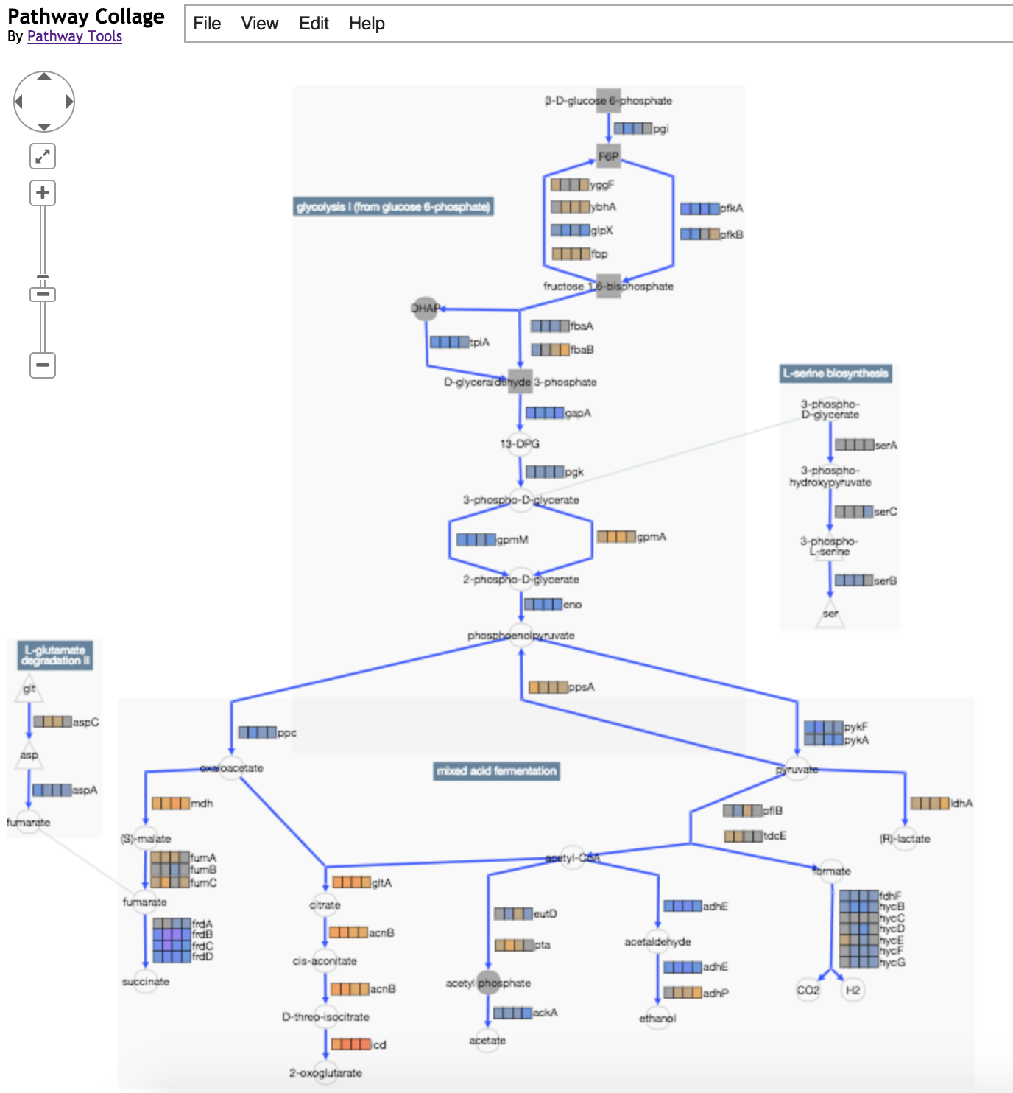

Slide 50
Operations
Adjust position of pathways, metabolites, etc.
Edit labels
Customize appearance of nodes, edges
Show connections between pathways
Merge duplicate metabolites, delete entities
Add pathways involving metabolite
Highlight metabolites, reactions, enzymes of interest
Show/Hide Omics Data
Tooltips provide links to BioCyc/PTools pages
Save/Reload/Export to PNG

Slide 51
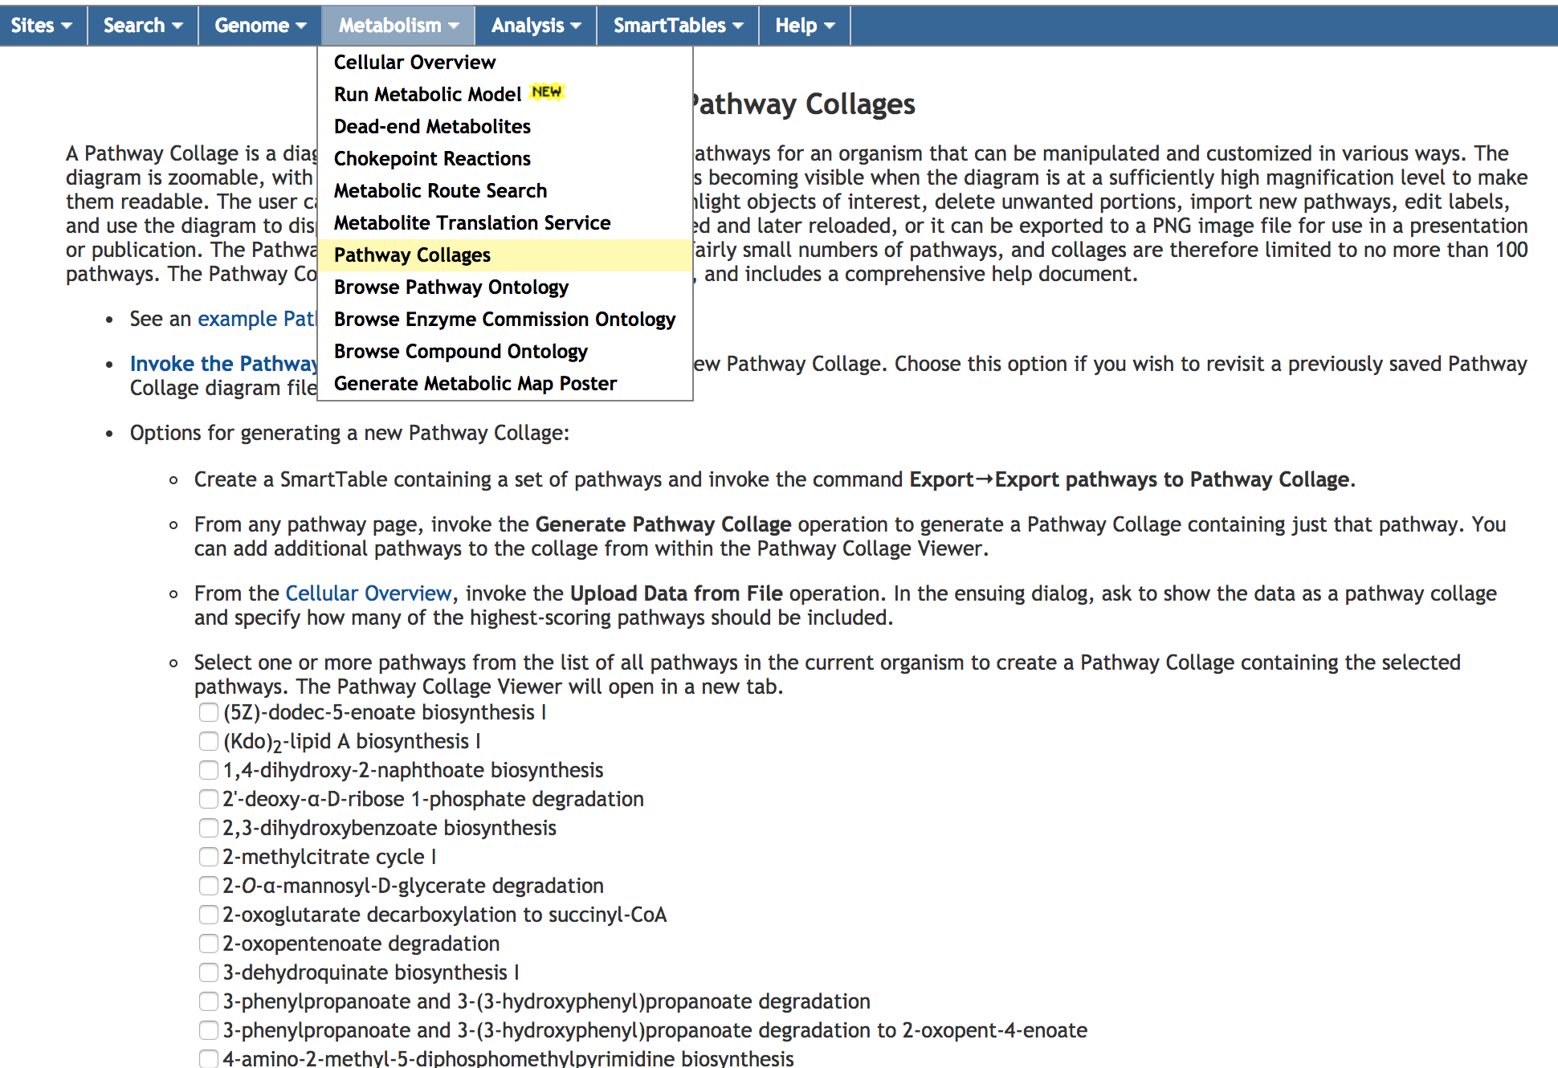
Accessing Pathway Collage App

Slide 52
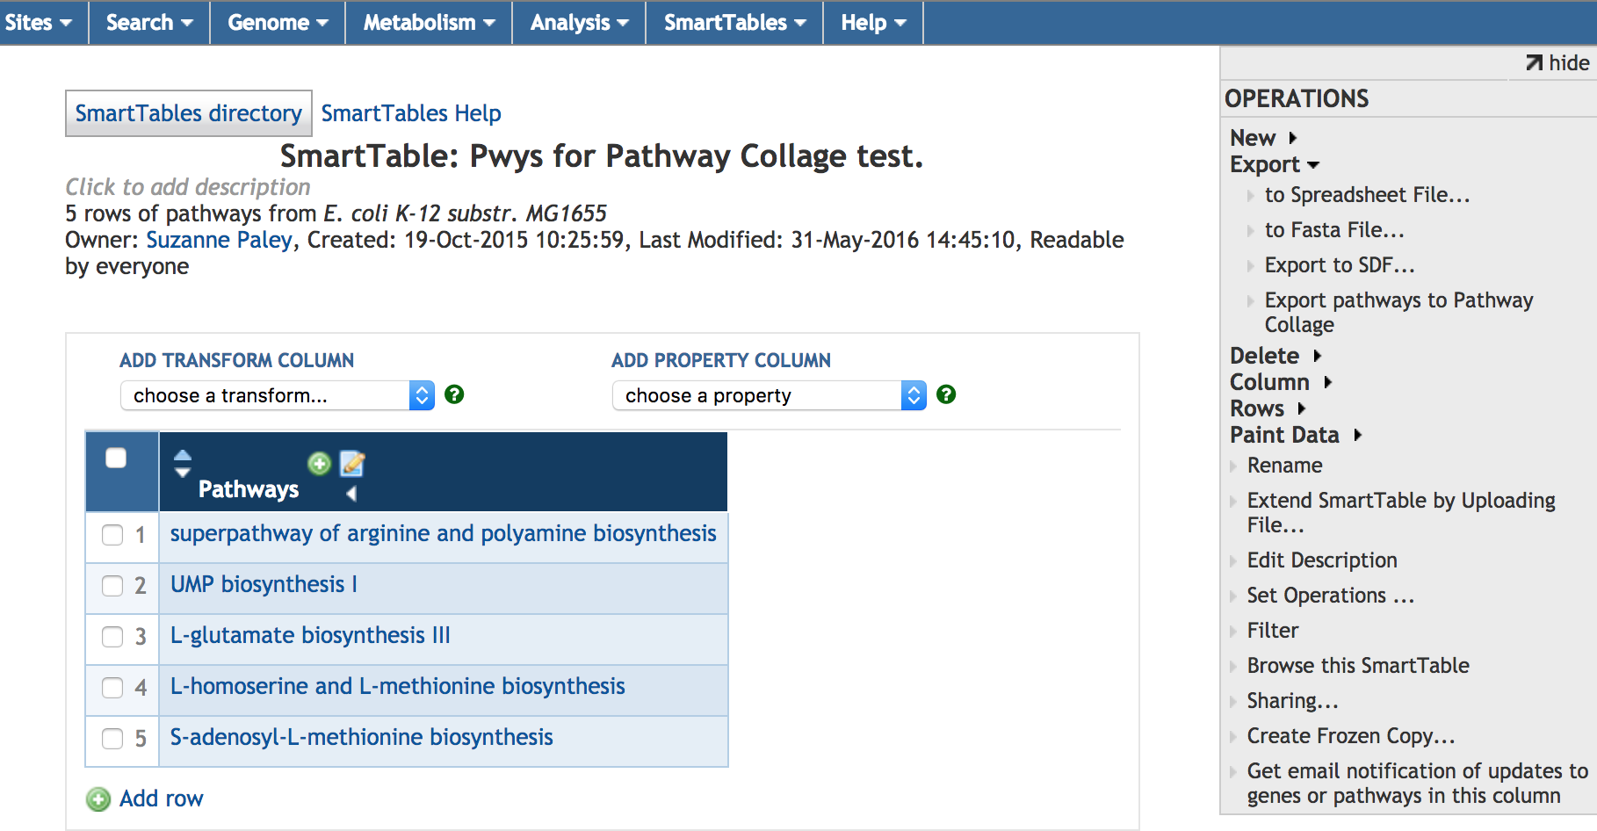
Pathway Collage from a SmartTable

Slide 53
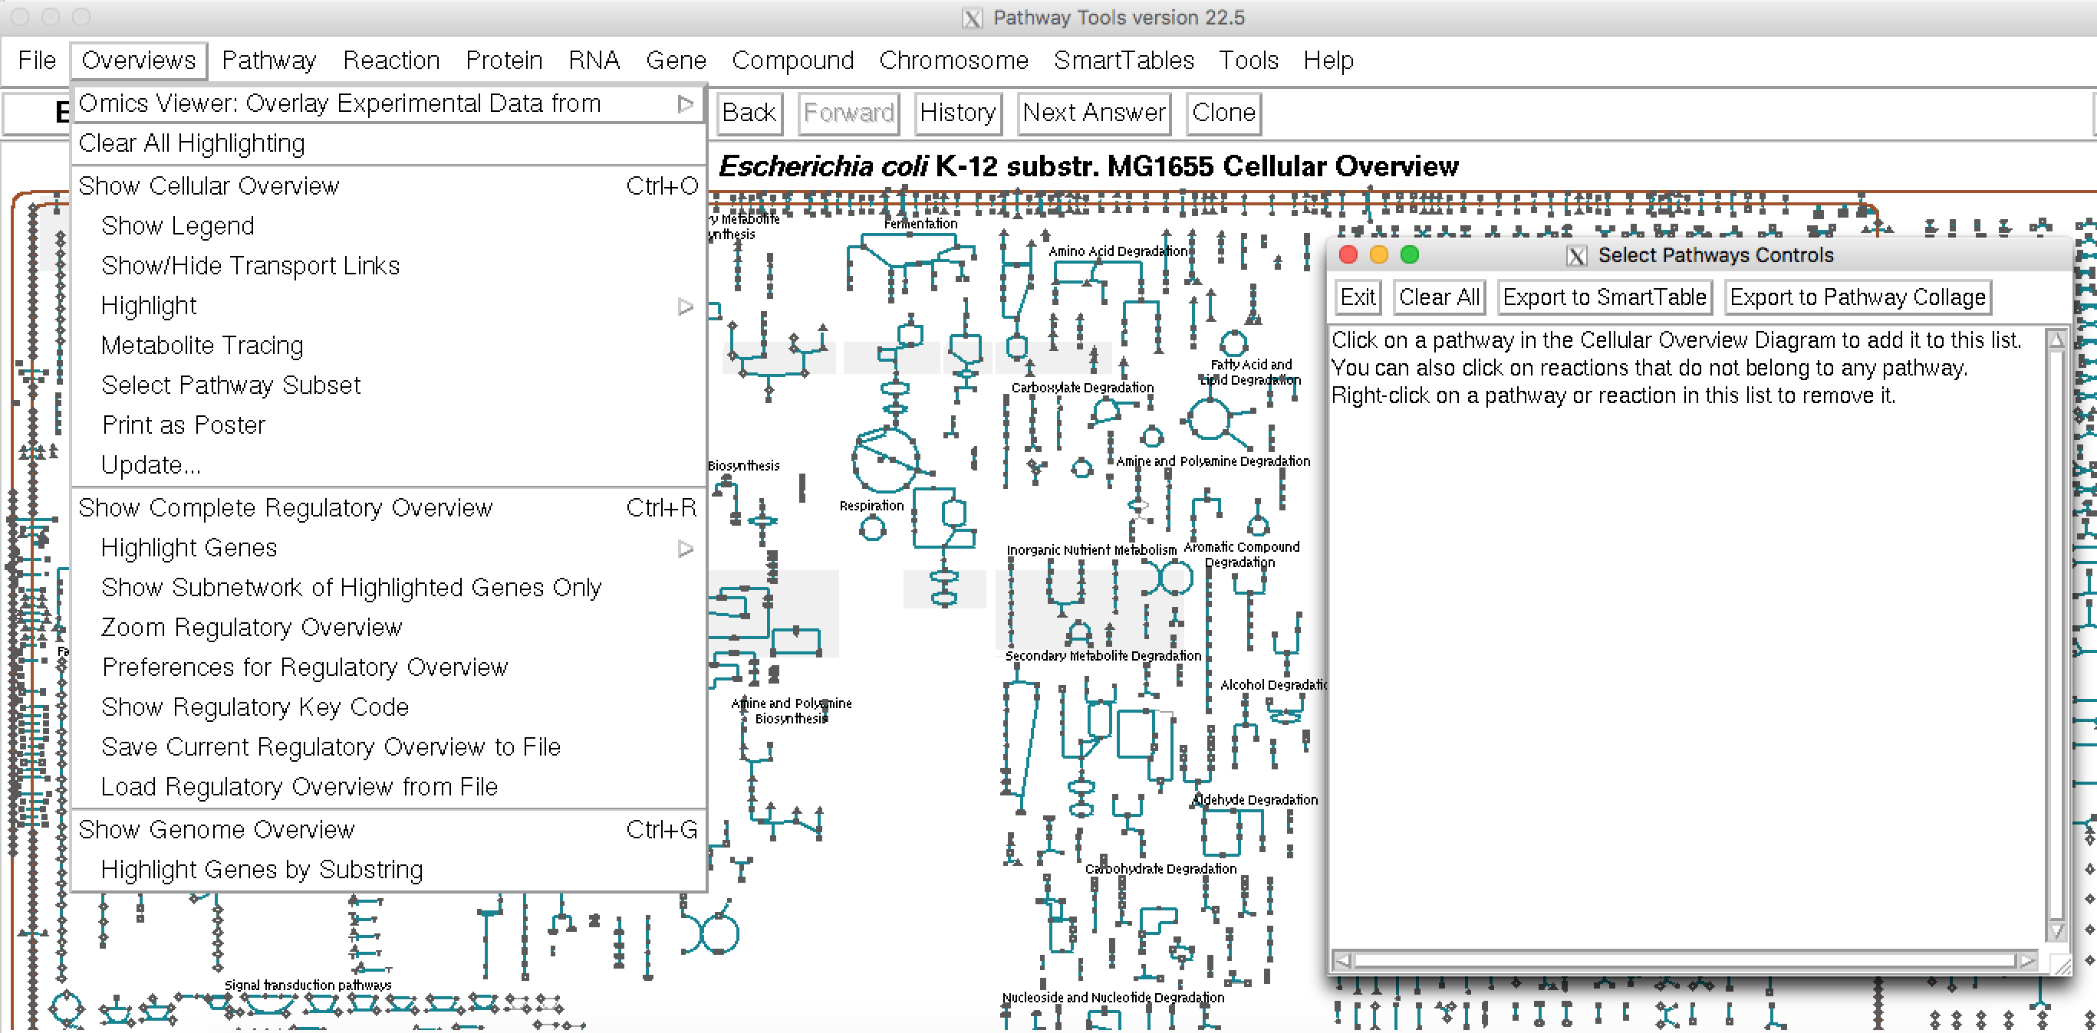
Pathway Collage from Desktop Software

Slide 54
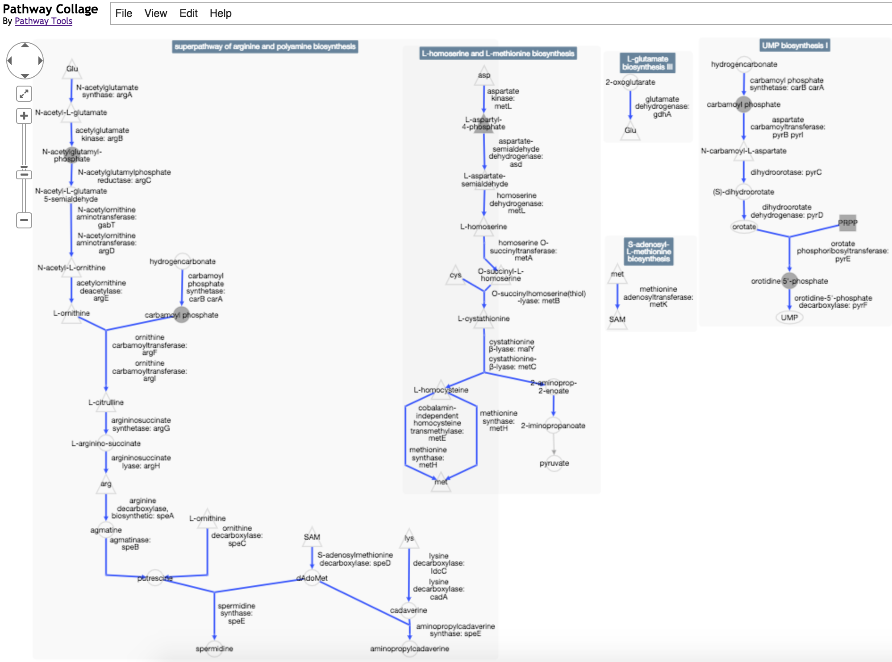

Slide 55
Other Omics Capabilities
Table of most perturbed pathways
SmartTable enrichment analyses and other transformations
Pathway Covering (web only)
Genome browser tracks

Slide 56
Pathway Perturbation Score
Extent to which a pathway is up/down-regulated
Based on reaction perturbation scores RPS or DRPS
Single time point: RPS based on fold change (FC) over all metabolites or genes of reaction
  RPS(R) = max(|FC(R)|) over all metabolites or genes associated with R
  PPS for pathway P computed from reactions R_{i} of P:
    PPS(P) = √sum(RPS(R_{i})²)
Multiple time points: DRPS based on maximum difference over all timepoints, over all metabolites or genes of reaction:
  DRPS(R) = max (|(max(FC(R)_{t1-N}) – min (FC(R)_{t1-N})|)
  DPPS(P) = √sum(DRPS(R_{i})²)

Slide 57
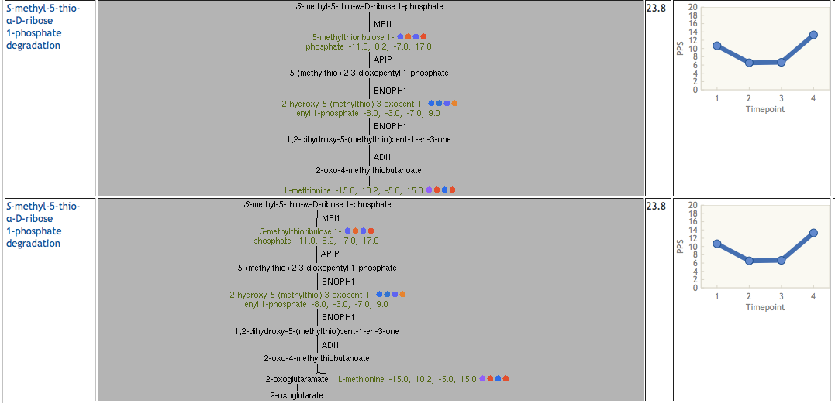
Paint Metabolomics Data onto
Table of Pathways Sorted by DPPS Score

Slide 58
Using SmartTables for Omics
Data Analysis
Define SmT from omics data file
Enrichment analysis
Groups → Transform Group →
  Pathways of Gene
  Significant Pathways of Gene
  Genes in Same Operon
  Regulators of Gene
  Enrichment Analysis

Slide 59
Exercises: Cellular Overview
Highlight the compound oxaloacetate. Show all reactions of oxaloacetate. Choose one of the nodes for oxaloacetate and draw connections to all others.
Highlight all reactions in EcoCyc that are regulated by ArcA.
Highlight all reactions in EcoCyc that are inhibited by ADP.

Slide 60
Exercises: Omics Viewer
Upload E. coli gene expression time series data from time-series.txt onto Cellular Overview Diagram.
  Relative data, 0-centered
  Show data columns 5-11
  Specify color scheme maximum cutoff 2
Stop animation, use arrows to change current timepoint.
Right-click on one or more interesting reactions and show omics popup.
Navigate to pathway and show omics popups on pathway diagram.
Perform analogous operations on EcoCyc website.

Slide 61
Exercises: Omics Dashboard
Upload E. coli gene expression time series data from ecoli-feuer-toaerobic-significant.txt onto Omics Dashboard.
  Absolute data
  Show data columns 1-6
Use Display Preferences to set default scale type to Log
Click on one or more interesting subsystems and drill down to gene level.
Drill down to gene level for a pathway-based subsystem, and click on buttons to Show Pathway and Show Operons.
Explore options and controls.

