Slide 1
Overviews, Omics Viewers, Pathway Collages
http://www.pathwaytools.org/tutorial/sessions/nav-omics/omics-viewers/overviews-omics.pptx

Slide 2
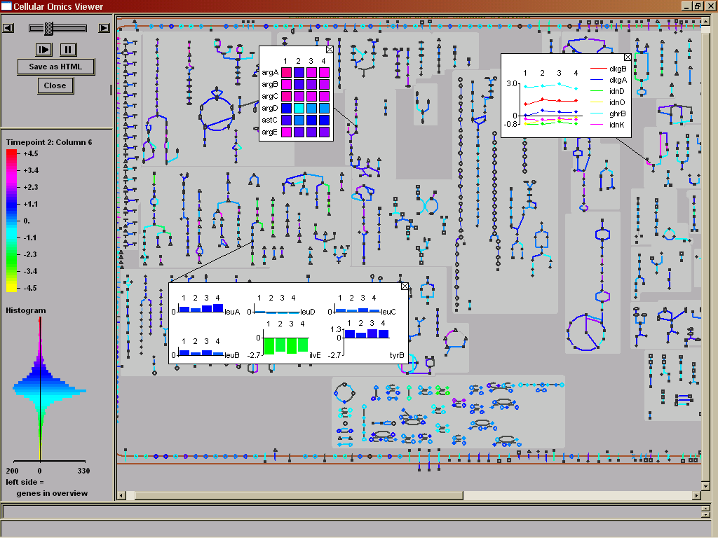
Introduction
Each overview is a system-level diagram of a different aspect of the cellular machinery
  Cellular Overview: metabolic and transport
  Regulatory Overview: regulation
  Genome Overview: genome
Overviews painted with omics data become omics viewers

Slide 3
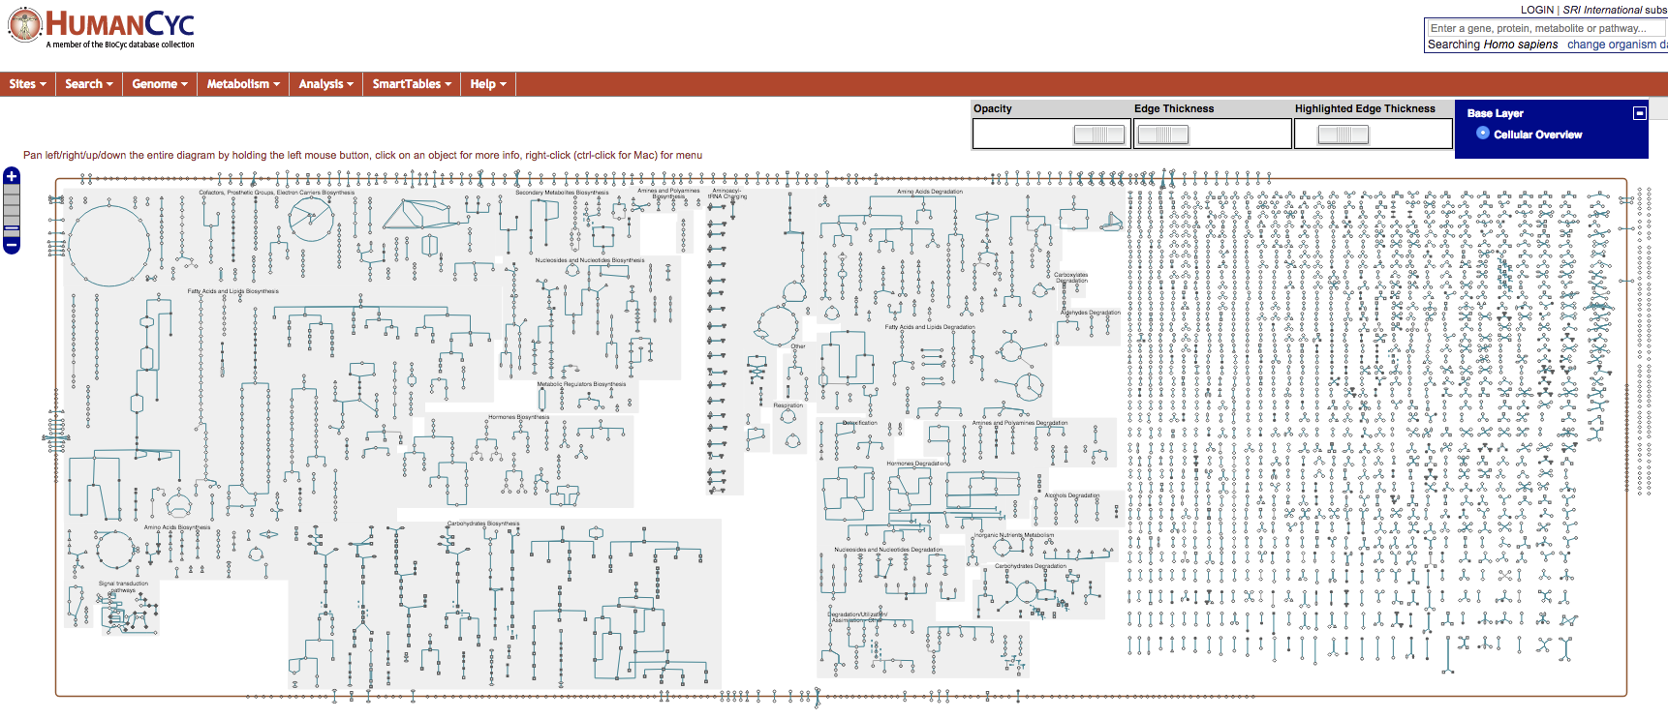
Cellular Overview Diagram
Combines metabolic map and transporters
Automatically generated, organism-specific
Zoomable, queryable

Slide 4
Organization of the
Cellular Overview
Organism specific, generated by Pathway Tools
Lines are reactions, nodes are biochemical species (compounds, proteins)
Legend explains symbols used
Pathways grouped functionally
  Anabolism left, catabolism right, energy in the middle
  Gray backgrounds indicate more specific functional groups
  Non-pathway reactions on far right
Generally, pathways flow downward

Slide 5
Physical Location in the Overview
Non-cytoplasmic proteins with known locations shown
  In E. coli, that means periplasmic, cell and outer membrane
  This includes proteins with no associated reaction
Desktop:
  Overview>Show/Hide Transport Links

Slide 6
Mouse-Over in the CellOv
Mousing over gray background identifies pathway class
Mousing over a node gives compound name and pathway
Mousing over a line gives reaction information
Can click through from anything to the PGDB

Slide 7
Zooming and Panning
Web mode:
  Hold mouse and drag to pan
  Click ladder at upper left, or double-click to zoom
Desktop: right-click to
  Zoom
  Pop up pathways
  Indicate pathway connections (clear in overview menu)
  More

Slide 8
Highlighting in the Overview
Desktop Mode
Overview>Highlight>many options
  Pathway by class (biosynthesis > all > select all)
  Reactions > All without EC numbers (note second color)
    Note all reaction options (many!)
  Reactions > By modulation
Can clear highlighting at any time
Can save highlighting to file for later use
Can do Genes and Compounds as well
Can pull information from a file, or from answer list

Slide 9
Highlighting in the Overview
Web Mode
Highlight cmds in right-sidebar
Clear/enable individual highlights using switching panel at upper right
Can save highlighting to file or URL for later use
  Right -> Generate Bookmark for Current Cellular Overview
Multiple highlight
  Highlight/Omics View Based on Names and Frame IDs

Slide 10
Highlighting to Compare Organisms
Desktop Mode
Look at shared or nonshared reactions
Example – E. coli reactions shared with humans
Example – switch to a second organism
  Reactions not shared with (human and coli)
  Set from Any to All
  One way to think about drug targeting, e.g.
Quick note – cross-species comparison from pathways
  Go to this from individual pathway pages
  Compares presence of pathway in question, and reactions of that pathway

Slide 11
Genome Overview Diagram
Shows genes schematically, not to scale (unlike Genome Browser)
Shows transcription units and direction of transcription
Shows protein versus RNA coding status
Mouse over for gene name, product, pathway participation, and intergenic spacing

Slide 12
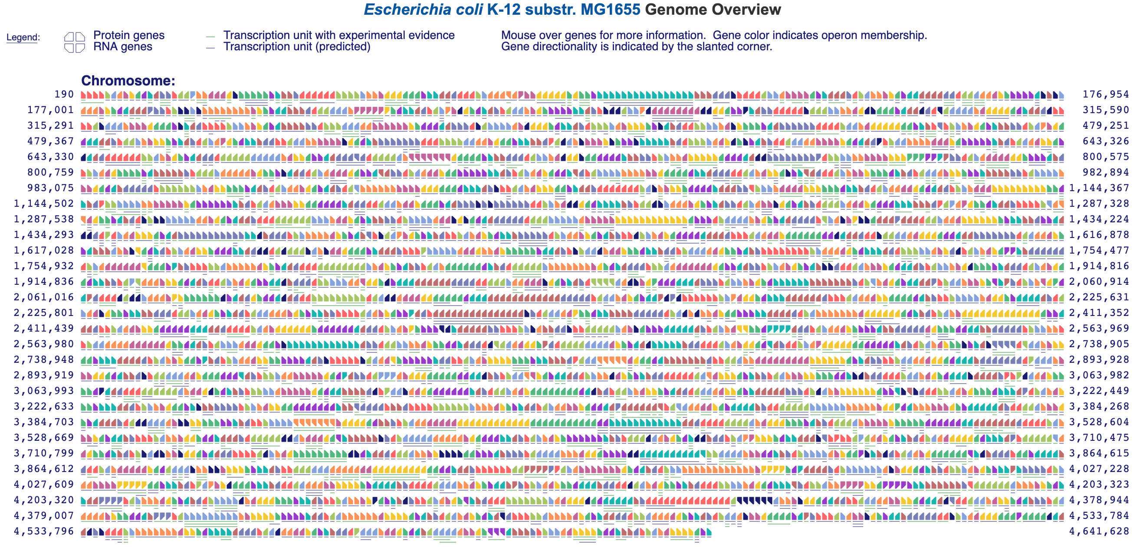
Genome Overview Diagram

Slide 13
Genome Overview
To enter (desktop mode):
  Overviews > Show Genome Overview
  Genome Browser: Click level 4 (Genome)
To enter (web mode):
  Genome > Genome Overview
  Genome Browser: Click level 4 (Genome)
Mouse over genes for more information
Desktop: Substring search available

Slide 14
Regulatory Overview
Displays regulatory network for an organism
Regulatory relationships must curated or loaded from an external database
Rings show regulatory status
  Inner – global regulators
  Middle – other regulators
  Outer – genes that are regulated only
Desktop: Overviews > Show Regulatory Overview
Web: Genome > Regulatory Overview

Slide 15
Exploring Regulatory Relationships
Pick a gene and right-click on it to see highlighting options
Can show direct and indirect regulators and regulatees
Display options available in the menu
  Change layout
  Display highlighted genes only
  Zoom and pan

Slide 16
Overviews and Omics Viewers

Slide 17
Metabolomics Applications
MetaCyc contains extensive multi-organism metabolite database (13,000)
Organism-specific metabolite databases in each PGDB
  Genome+pathway context for interpreting metabolomics data
Search for monoisotopic mass + chemical formula
SmartTable management of metabolite sets
  Metabolite->pathway transformation
  Pathway enrichment analysis
  Pathway perturbation computation
Paint metabolomics data onto pathways
Metabolite translation service
  biocyc.org/web-services.shtml

Slide 18
Overview of Omics Data
Analysis in BioCyc
Omics Viewers
  Cellular Overview, Regulatory Overview, Genome Overview
  Omics pop-ups
  Omics data on pathways, pathway collages
  Omics data on table of pathways
Omics Dashboard
Metabolomics
  Monoisotopic mass search (Search -> Compounds)
  Metabolite translation service
    http://biocyc.org/metabolite-translation-service.shtml
  Pathway Covering
Genome Browser tracks

Slide 19
Overview of Omics Data
Analysis in BioCyc
SmartTables
  Define sets of differentially regulated genes or metabolites
  Browse
  Share with colleagues
  Perform enrichment analysis
  Transform to operons
  Transform to significantly expressed pathways

Slide 20
The Omics Viewers
Visualize any data that attaches numbers to genes, proteins or compounds
  Proteomics, metabolomics, genomics, combinations thereof
Data sources:
  Tab-delimited files
  Keyboard (web only)
  GEO – search by keyword
  Metabolomics Workbench (desktop only)
  SmartTable

Slide 21
Desktop vs Web Omics Viewers
Different graphical / interaction styles
 | Desktop | Web
Save/Restore State | ✔
Screen Grab | ✔ | ✔
Animate Multiple Time Points | ✔ | ✔
Save-as-HTML (video) | ✔
One dialog to all viewers | ✔
Genome Omics Viewer | ✔

Slide 22
Using the Omics Viewers
Data file format
  Tab separated columns
  One or more object names / IDs in column zero
    id1$name1$id2$name2$id3
    trpA
    trpA$b0383
    spermidine$KEGG:C00315$PubChem:6992097
  Columns can contain any numeric data
    Gene expression, proteomics, metabolomics, reaction fluxes
  Labels can be specified in first non-comment line:
    $T=0 T=20 T=40

Slide 23
Viewing Multiple Data Sets
Compare multiple data points using animation
Typically a time course, but does not have to be
Tell Pathway Tools which columns to use
Same output color / cutoff selections as single experiment
If you use automatic color scale, it’s set to the maximum shift in the experiment
  Thus, all time points / data sets comparable
  A good way to standardize across experiments
Can move between experiments/time points manually
Can save as HTML (desktop)

Slide 24
Omics Viewer Output
Data report
  Total data rows
  Data rows not shown
  Data rows with invalid data
  Color key
Display options
  Set maximum cutoff for default color scheme (e.g. 0.3)
  Set manual color cutoffs (e.g. 0.3, 0.6, 0.9)
  Both options let you compare different experiments

Slide 25
Omics Viewer Options
Relative vs absolute
  Absolute: Concentrations or molecule counts. Negative values are ignored.
  Relative: Ratios with or without log transform
0-centered vs 1-centered scale
  0-centered = log scale with positive and negative values
  1-centered = linear scale, centered on 1
    Ratios
    Negative values ignored

Slide 26
Omics Viewer Color Schemes
Full color spectrum from data
  Data from one file mapped to full color spectrum
  Different experiments will receive different color assignments
Full color spectrum with max cutoff
  User specifies cutoff
  Useful for comparing datasets
Three color display with threshold
  Three color bins: x < 1/T , 1/T < x < T, x > T
User-defined bins with computer colors
User-defined bins with user colors

Slide 27
Web Omics Viewer
Mouse-over for omics pop-ups
Right-click reaction or metabolite for omics-popup for pathway
To see omics data on individual pathway:
  Navigate to pathway page
  Sidebar > Customize or Overlay Omics Data on Pathway Diagram

Slide 28
Desktop Omics Viewer

Slide 29
Omics Data Graphing on Cellular Overview

Slide 30
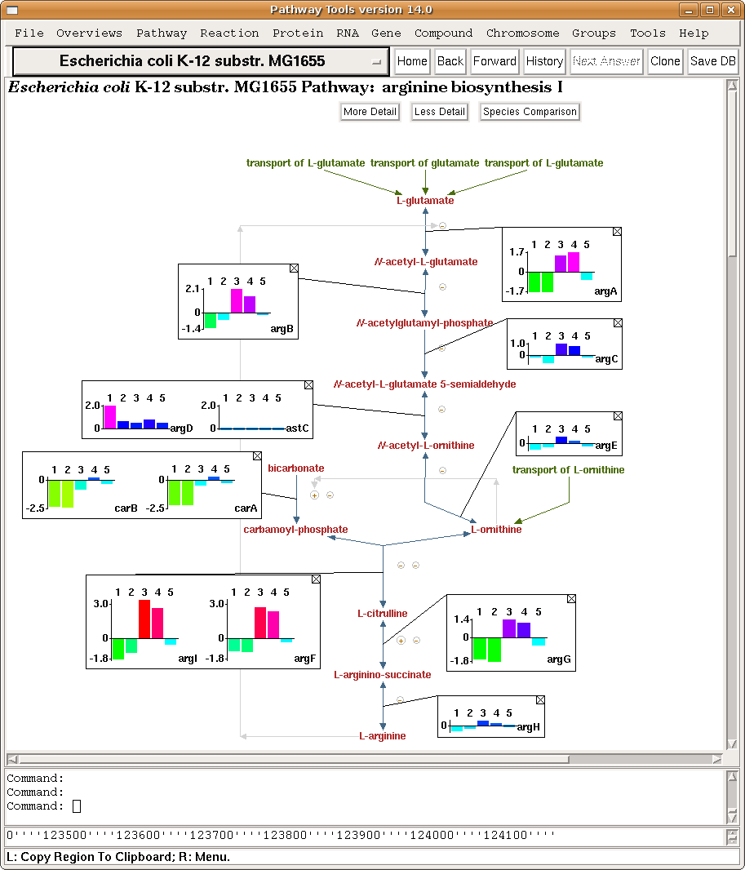

Slide 31
Pathway Perturbation Score
Extent to which a pathway is up/down-regulated
Based on reaction perturbation scores RPS or DRPS
Single time point: RPS based on fold change (FC) over all metabolites or genes of reaction
  RPS(R) = max(|FC(R)|) over all metabolites or genes associated with R
  PPS for pathway P computed from reactions R_{i} of P:
    PPS(P) = √sum(RPS(R_{i})²)
Multiple time points: DRPS based on maximum difference over all timepoints, over all metabolites or genes of reaction:
  DRPS(R) = max (|(max(FC(R)_{t1-N}) – min (FC(R)_{t1-N})|)
  DPPS(P) = √sum(DRPS(R_{i})²)

Slide 32
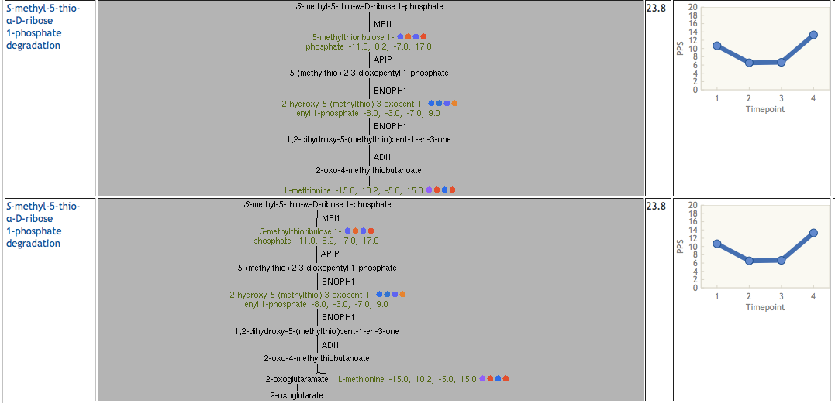
Paint Metabolomics Data onto
Table of Pathways Sorted by DPPS Score

Slide 33
Using SmartTables for Omics
Data Analysis
Define SmT from omics data file
Enrichment analysis
Groups → Transform Group →
  Pathways of Gene
  Significant Pathways of Gene
  Genes in Same Operon
  Regulators of Gene
  Enrichment Analysis

Slide 34
Pathway Collages
User-defined pathway diagrams
Optionally painted with high-throughput data
Define via SmartTable
Example:
  http://biocyc.org/group?id=biocyc14-61-3670184769

