Slide 1
RouteSearch
A tool to find metabolic routes in a reaction network
and
optimize new routes based on reactions from MetaCyc
Wai Kit Ong
March 2017

Slide 2
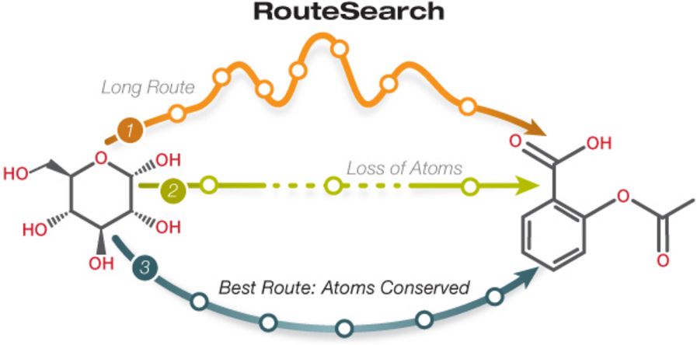
Objective of RouteSearch
Finding the least cost route from a source compound to a target compound taking into account atoms lost, the length of the path, and the cost of adding new reactions.
Can be used for:
Analyzing efficient pathways in an organism
Engineering new productive metabolic pathways (non-native reactions from MetaCyc)

Slide 3
Using RouteSearch
RouteSearch is available as a web interface only (not on Pathway Tools desktop)
If new routes from MetaCyc are desired:
  Start Pathway Tools web server
  Use the “-www -metroute-metacyc” start up options
Select the organism to “search” from link “change organism database” on web page
RouteSearch is accessible from command “Metabolic Route Search” under the top menu bar “Metabolism”

Slide 4
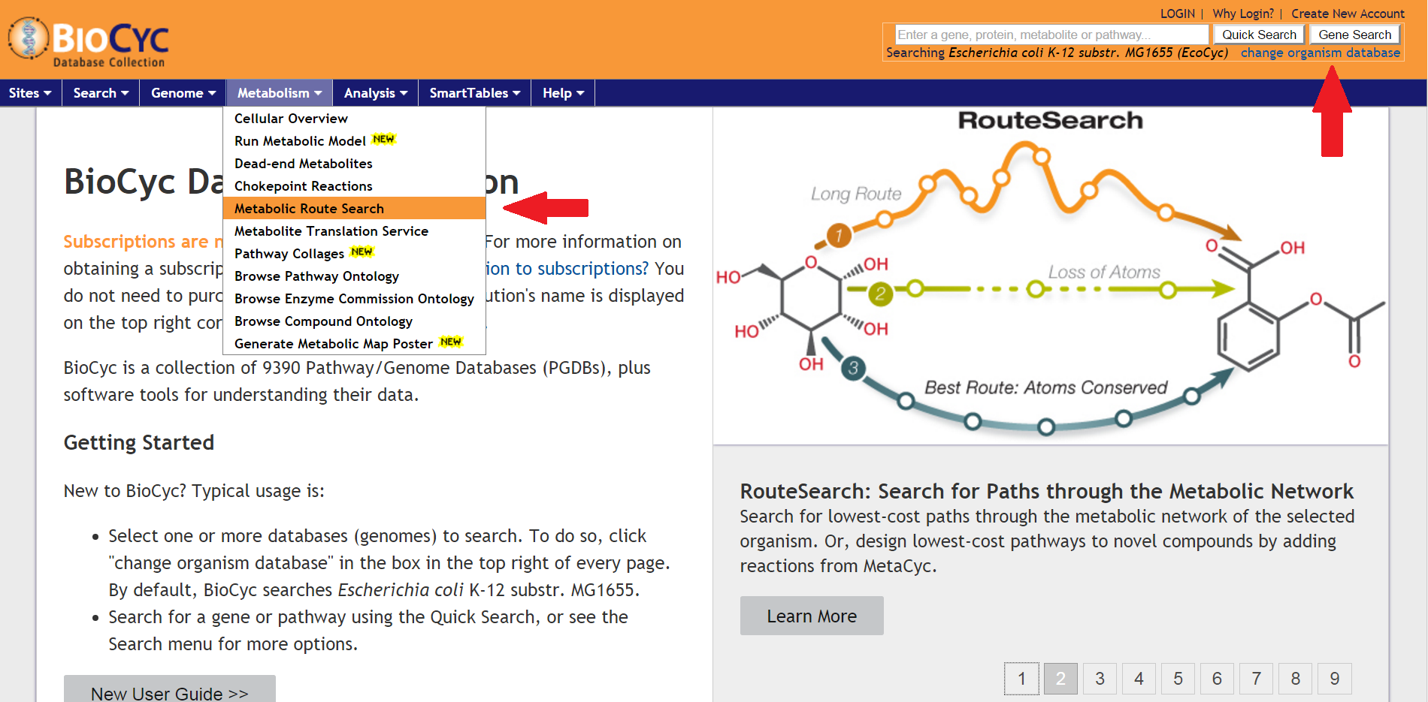
Opening RouteSearch

Slide 5
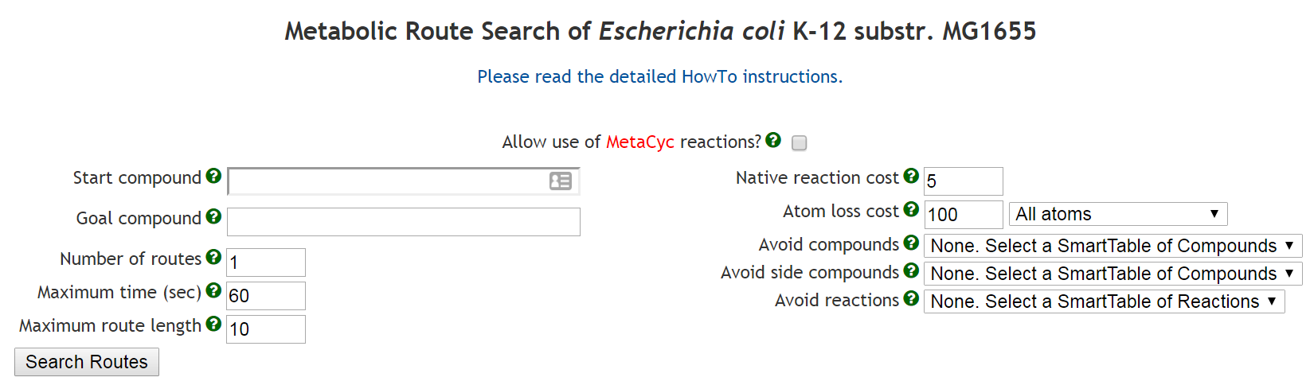
Web Interface

Slide 6
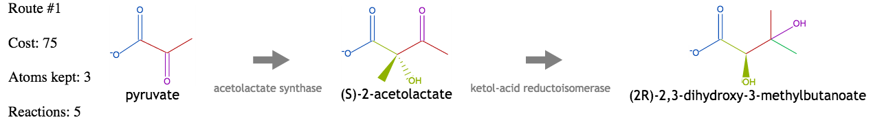
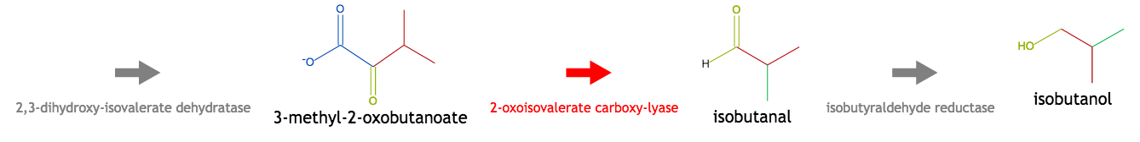
Example 1
From pyruvate to isobutanol (EcoCyc and MetaCyc)
Best route: 2 carbon atoms and 1 oxygen atom conserved; 5 reactions, 1 from MetaCyc
MetaCyc reaction cost = 10, Native reaction cost = 5, Atom lost cost = 15

Slide 7
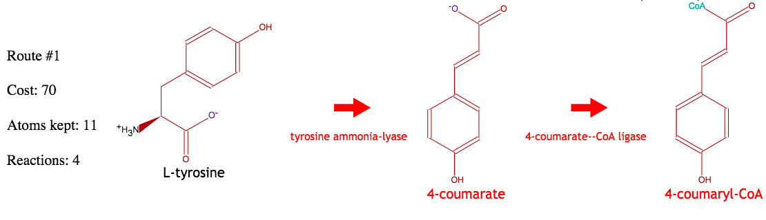
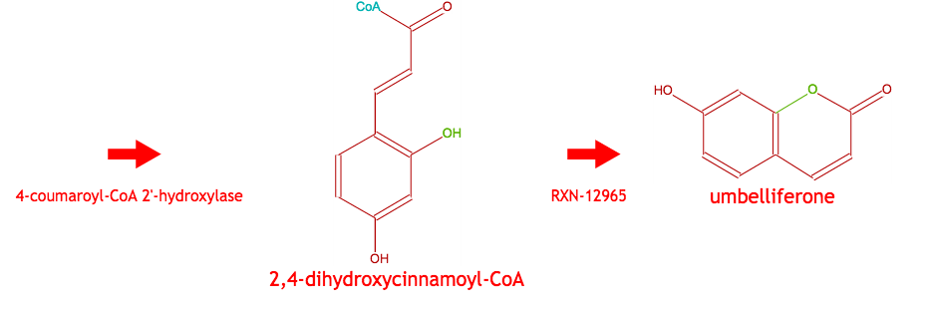
Example 2
From L-tyrosine to umbelliferone
Best route: 9 carbon atoms and 2 oxygen atoms conserved; 4 reactions from MetaCyc
MetaCyc reaction cost = 10, Native reaction cost = 5, Atom lost cost = 15

Slide 8
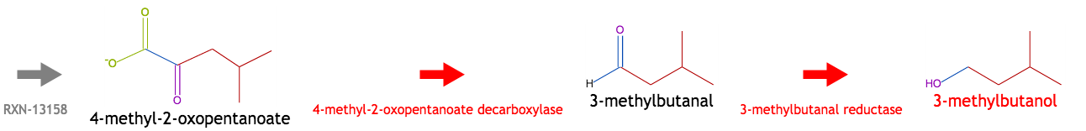
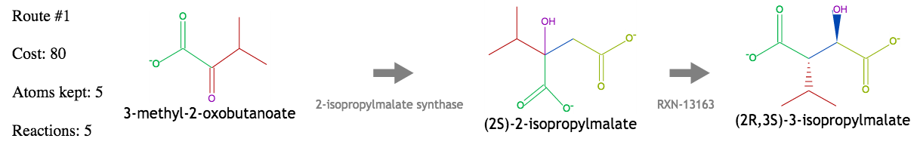
Example 3
From 3-methyl-2-oxobutanoate to 3-methylbutanol
Best route: 4 carbon atoms and 1 oxygen atom conserved; 5 reactions, 2 from MetaCyc
MetaCyc reaction cost = 10, Native reaction cost = 5, Atom lost cost = 15

Slide 9
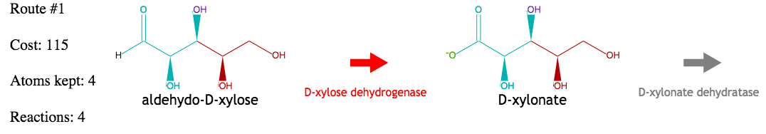
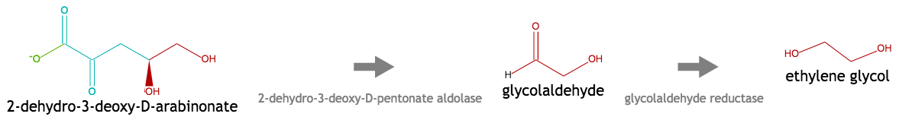
Example 4
From aldehydo-D-xylose to ethylene glycol
Best route: 2 carbon atoms and 2 oxygen atoms conserved; 4 reactions, 1 from MetaCyc
No path exists in EcoCyc alone that conserves any atoms
MetaCyc reaction cost = 10, Native reaction cost = 5, Atom lost cost = 15

Slide 10
Algorithm, Atom Mappings
RouteSearch uses a Branch-and-Bound algorithm
Its efficiency depends on the length and number of routes
MetaCyc reactions (> 12,000) have atom mapping data
Available at BioCyc.org without MetaCyc
Install Pathway Tools to enable search using MetaCyc

Slide 11
Reference
Mario Latendresse, Markus Krummenacker, Peter D. Karp, Optimal metabolic route search based on atom mappings, Bioinformatics, doi: 10.1093/bioinformatics/btu150, March 2014
Research was funded by the Department of Energy (DoE)

