Slide 1

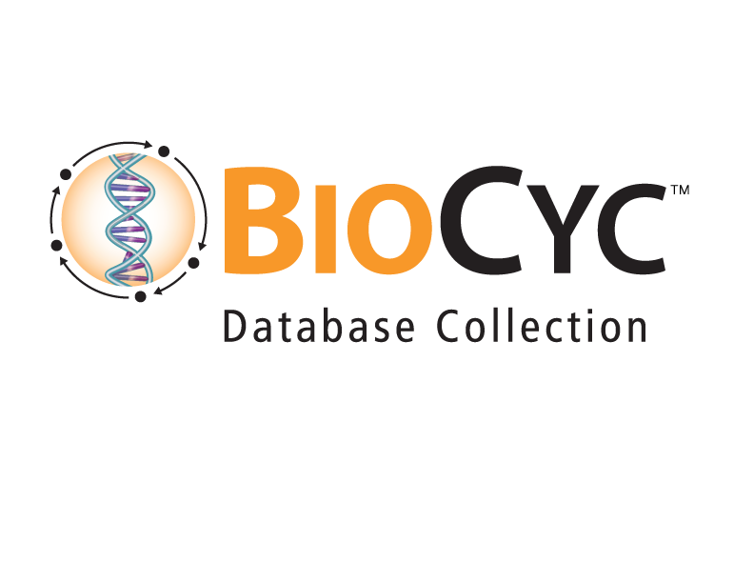
SmartTables
Peter D. Karp ecocyc.org
SRI International biocyc.org
metacyc.org

Slide 2
SmartTables
Define lists of database objects
  Genes, metabolites, pathways, sequence regions, …
Browse their properties
Transform them into related objects
(eg: transform list of genes → list of pathways)
Filter and combine
Share with public or specific collaborators
Export to spreadsheet
Omics analyses

Slide 3
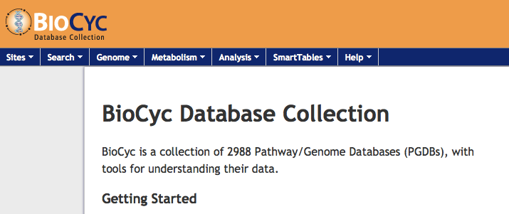
SmartTables Location
BioCyc.org, HumanCyc.org, EcoCyc.org…
To create saved SmartTables, create a (free) BioCyc account for yourself
From the web menu:
SmartTables->My SmartTables

Slide 4
Three Types of SmartTables
Created by you
Created by other users (public/private)
  SmartTables -> Public SmartTables
  Make your own copy to edit
Special
  SmartTables -> Special SmartTables
  All pathways, all metabolites

Slide 5
Creating SmartTables
SmartTables are associated with a PGDB
Only objects in that PGDB can be added to a SmartTable
SmartTable rows and columns can contain
  PGDB objects and data fields
  Text strings that are not bound to a PGDB object

Slide 6
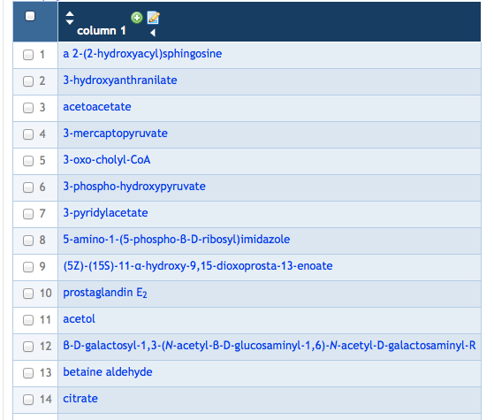
Creating SmartTables: User-Defined SmartTables
Create a SmartTable
  Type in metabolite names
  From search results
  Upload a tab-delimited text file

Slide 7
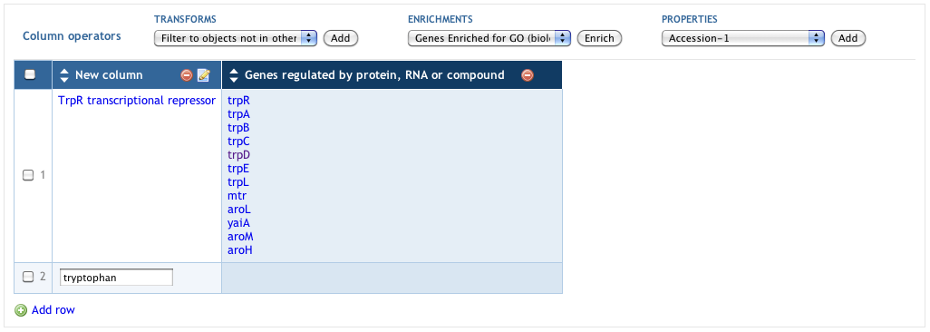
Creating SmartTables: User-Defined SmartTables
Create a SmartTable by typing in names
Operations -> New -> SmartTable of Objects from Text Entry
Names will be converted to rows of objects

Slide 8

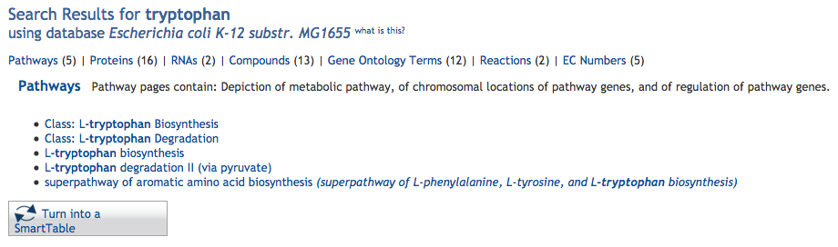
Creating SmartTables from Search Results
“Turn into a SmartTable” button appears on all search results

Slide 9
Define a ST by importing the file ST000061… for human adipose tissue
Show how to delete and add rows manually
Show how to Rename columns, sort, collapse columns, etc

Slide 10
The following browsing slides are perhaps too detailed to show during the tutorial, but could be hidden and kept here as reminders of what to show live

Slide 11
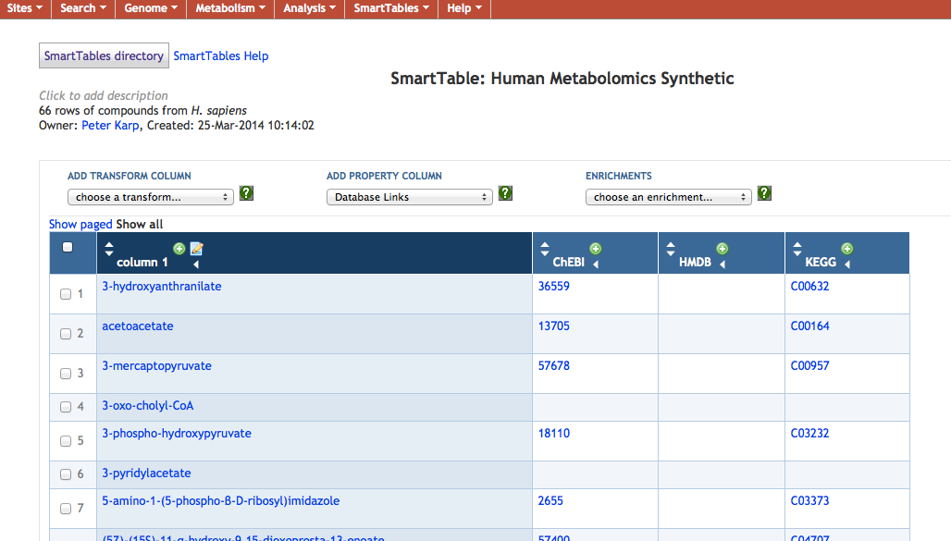
Using SmartTables: Browsing Attributes

Slide 12
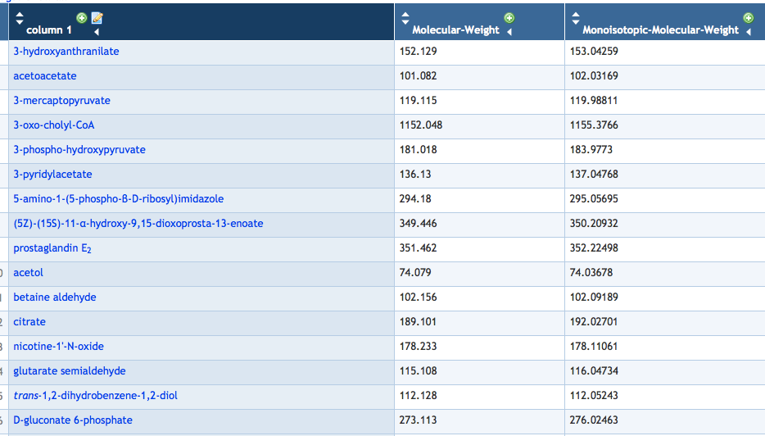
Using SmartTables: Browsing Attributes

Slide 13
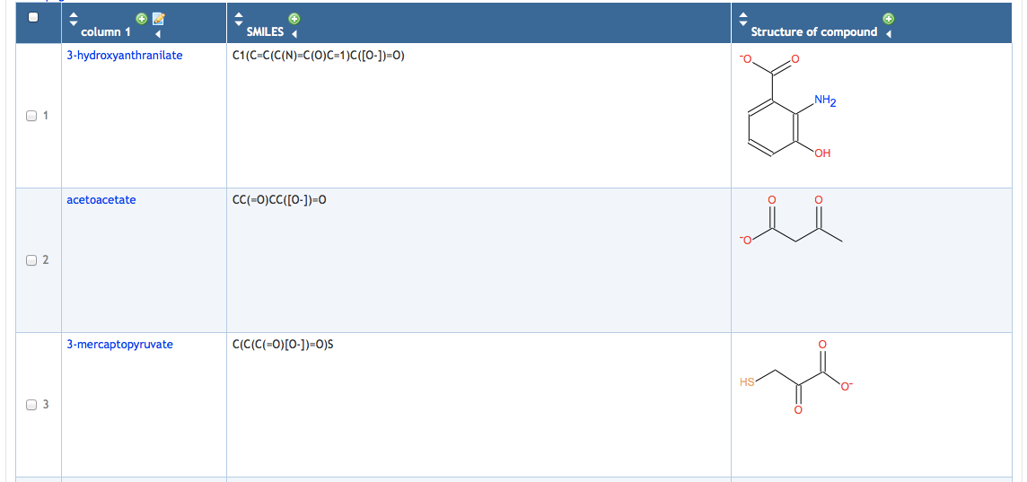
Using SmartTables: Browsing Attributes

Slide 14
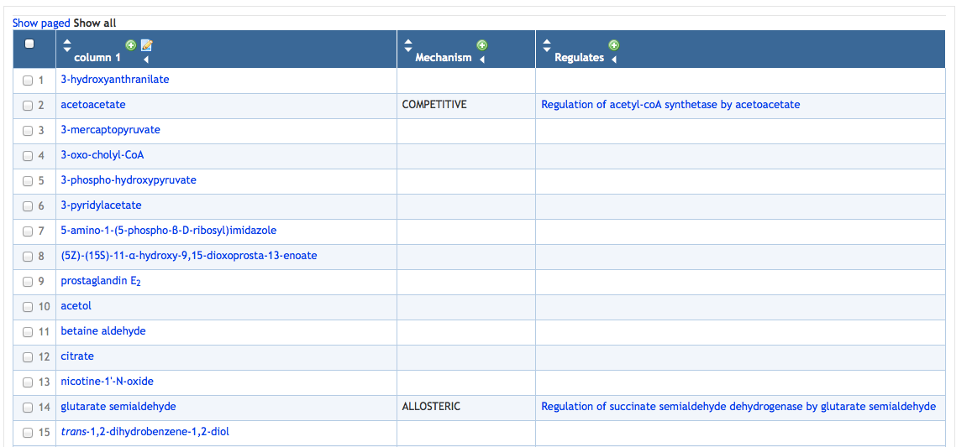
Using SmartTables: Browsing Attributes

Slide 15
SmartTable Transformations
Create new columns that are computed from existing columns

Slide 16
Similarly, the following slides could be hidden to serve as reminders for what to show live

Slide 17
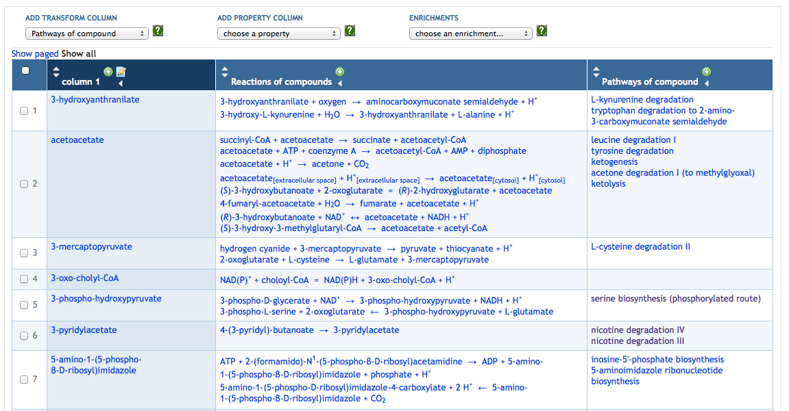
Transformations: Reactions and Pathways of Metabolite

Slide 18
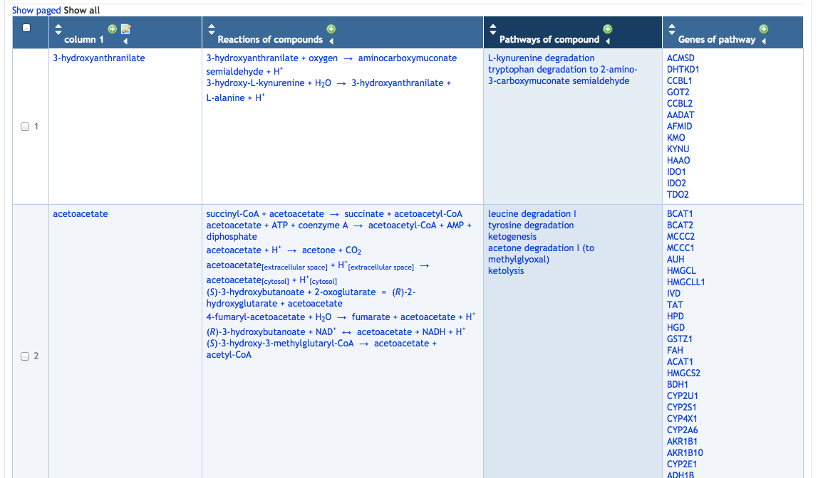
Transformations: Genes of Pathway

Slide 19
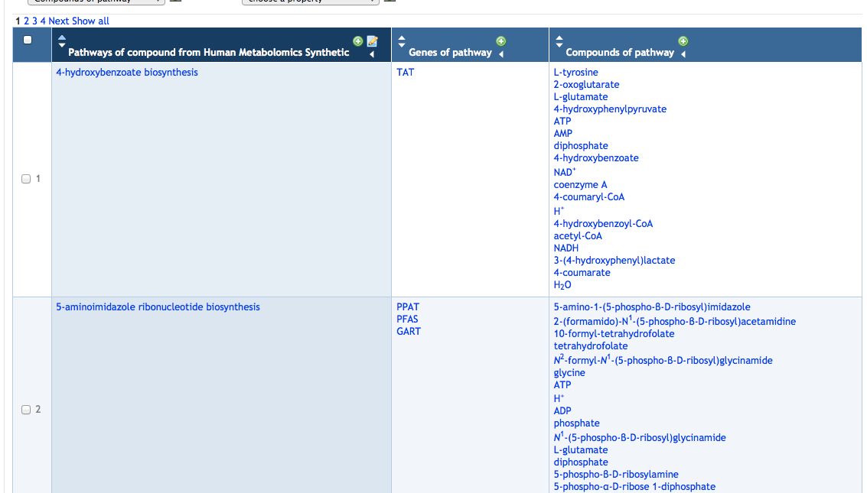
Transformations: New SmartTable from Column

Slide 20
Using SmartTables: SmartTable Transformations
Find all genes that are regulated by a transcriptional regulator.
Create a SmartTable that contains the transcription factor.
In the “Transforms” menu, select “Regulation – genes regulated by polypeptide, complex, or RNA”.
A new column containing all genes regulated by the transcription factor is generated.
This SmartTable can be further transformed, e.g. into metabolic pathways.
The resulting lists can be exported.

Slide 21
Using SmartTables: Attributes
Find the chromosome positions of all genes encoding enzymes of a pathway, sort by position. Find regulators of those genes.
Create a group that contains the pathway.
In the “Transforms” menu, select “Genes of pathway”.
Select gene column and select
  Operations > New > Group from column OR
  Click “+” at top of gene column
Select “left-end-position” from “Add Property Column” menu and add.
Sort by position by clicking on arrow in column header.
Select “Direct regulators of gene” from “Add Transform Column” menu.

Slide 22
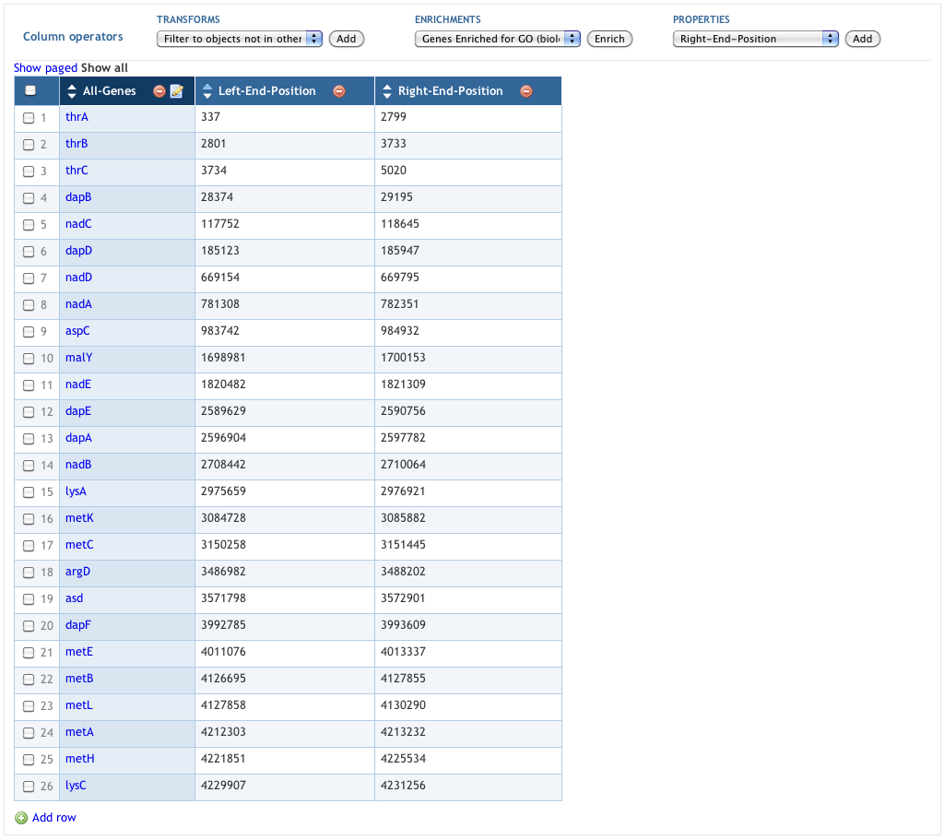
Genes of Aspartate Superpathway

Slide 23
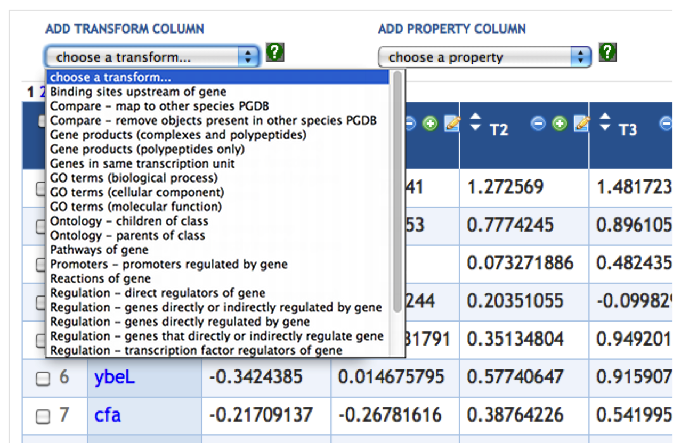
Transforms

Slide 24
Other Operations on SmartTables
Set union, intersection, difference among two SmartTables
Filter SmartTable rows to keep/reject all rows containing specified value or substring or regular expression
Share SmartTable with public or specified users
Freeze SmartTable for publication

Slide 25
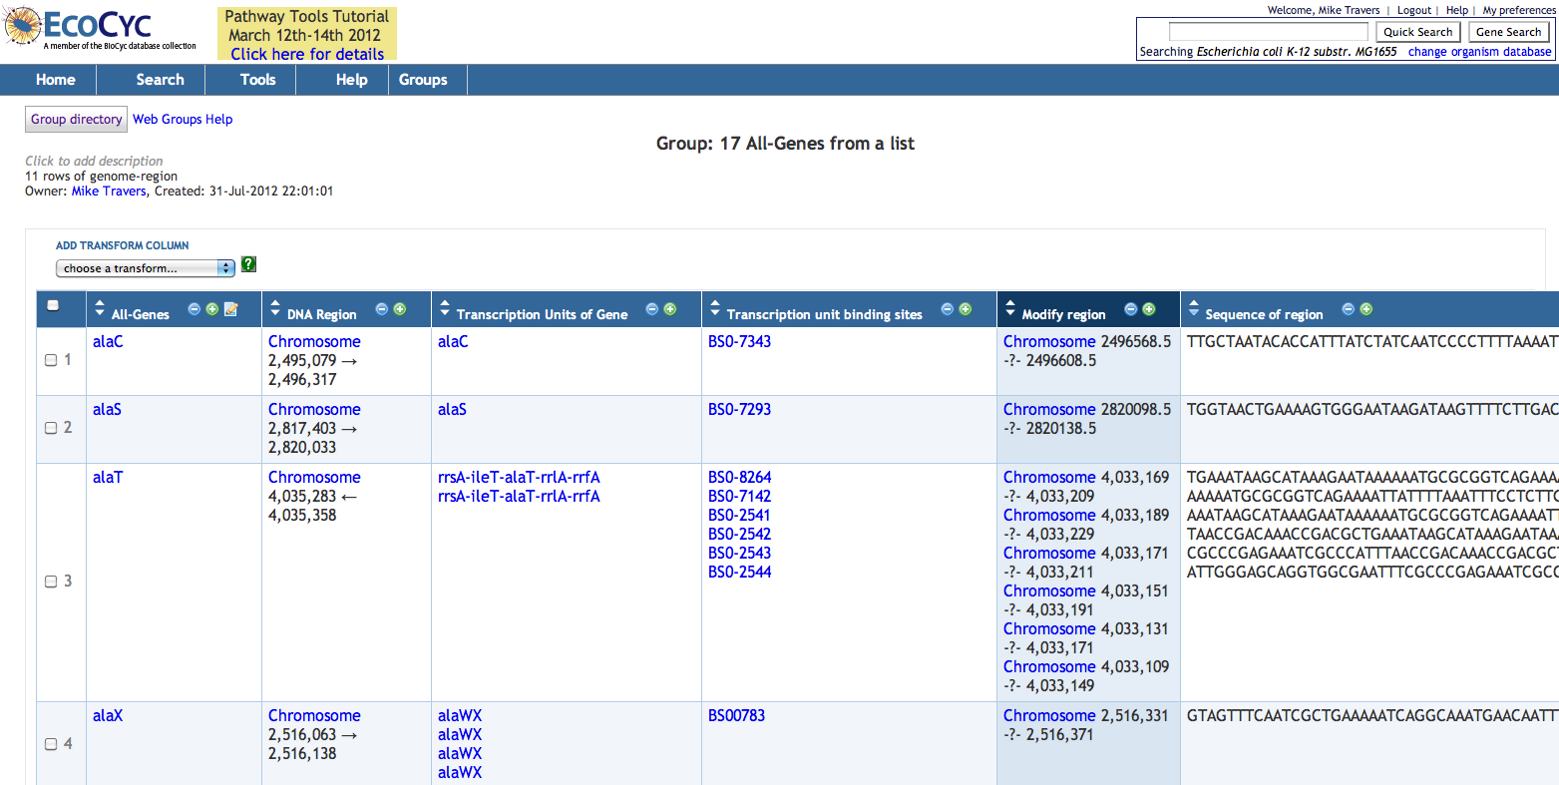
Genes, Sequences, Regions….

Slide 26
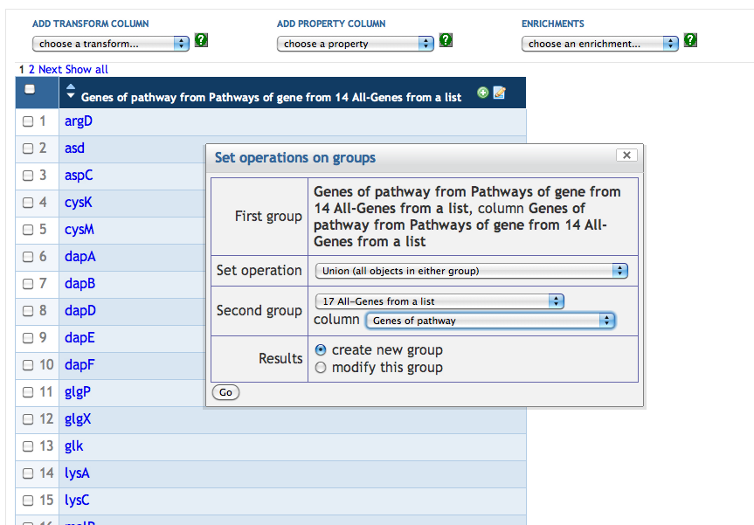
Set Operations on SmartTables

Slide 27
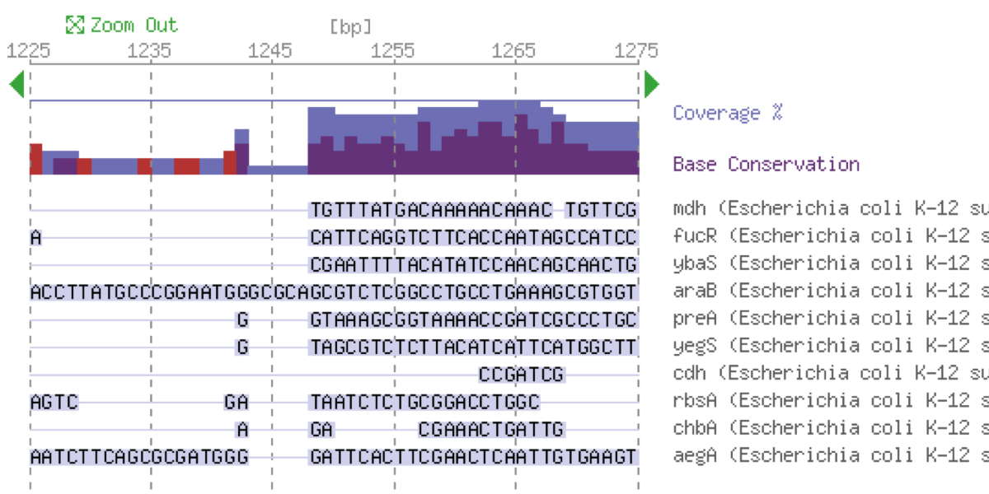
Alignment Viewer

Slide 28
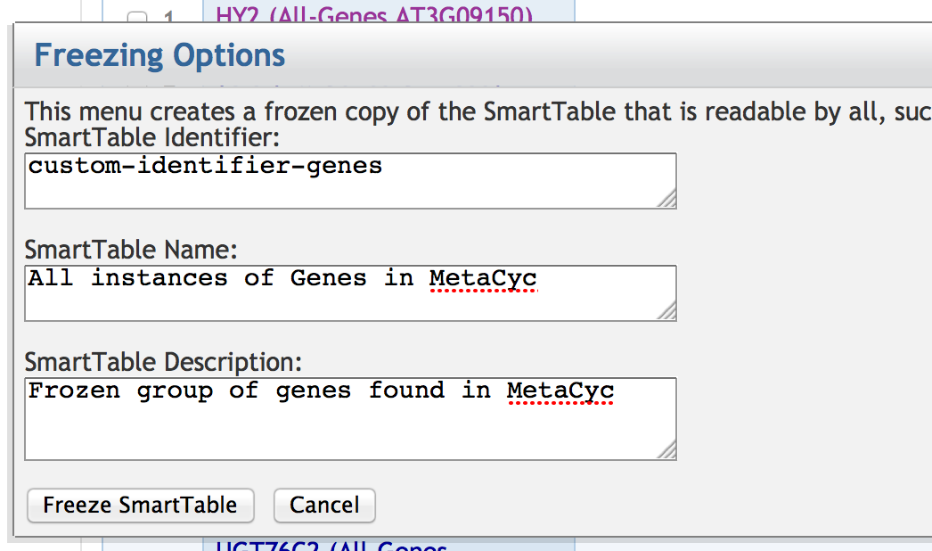
Frozen SmartTables

Slide 29
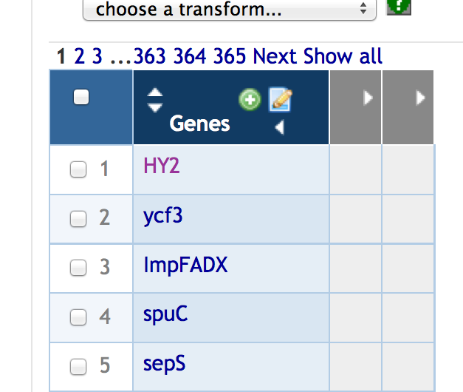
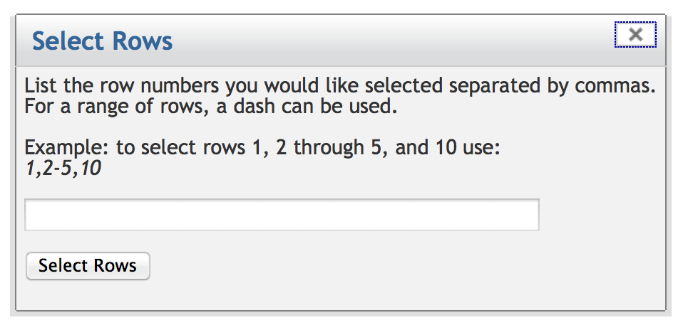
Collapsible Columns, Select Rows By Number

Slide 30
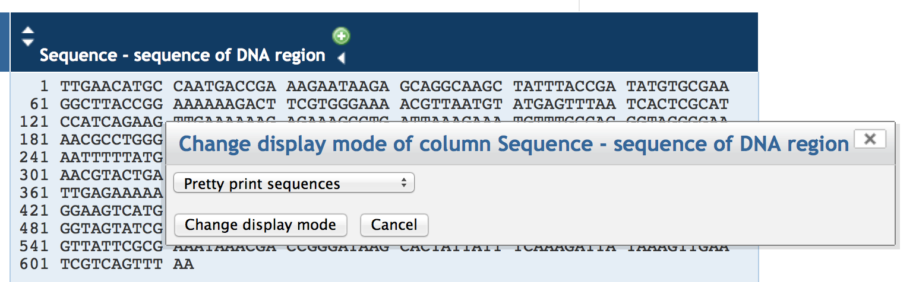
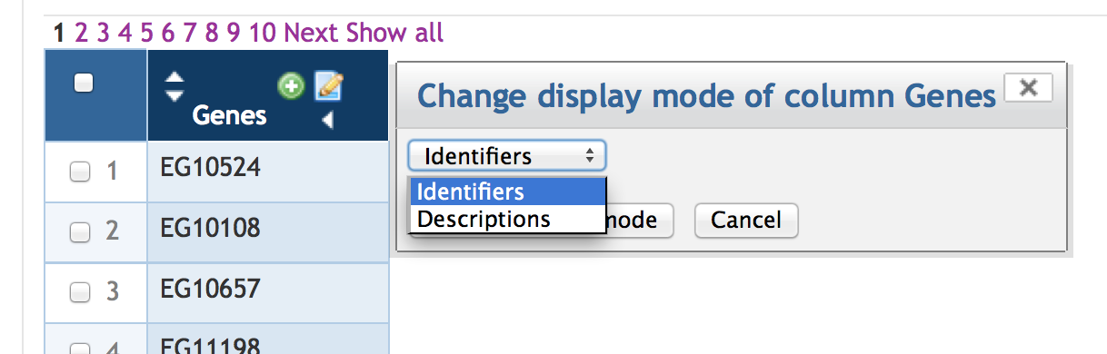
Display Modes

Slide 31
Enrichment Analysis
* Statistical method to find classes of objects that have more or less objects than would be expected by chance
* Based on the Hypergeometric Distribution
* Can perform enrichment, depletion, or both
* Multiple ontologies can be used in Pathway Tools
* Multiple testing correction optional

Slide 32
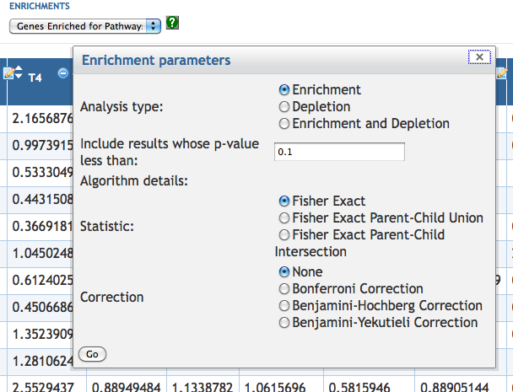
Enrichment Dialog

Slide 33
Lab Exercise
Select a PGDB; search for compounds that have ‘pyruvate' in their name
Turn into a SmartTable
Manually remove a few compounds then add a few compounds
Perform an enrichment analysis
Select ten most enriched pathways
Operations → New → From checked rows
Transform to reactions of pathway
New SmartTable of reactions (green button on column)
Operations → Paint Data → On cellular overview

Slide 34
Lab Exercise
Create a SmartTable containing all E. coli monomers with a molecular weight greater than 500
Add column containing their genes
Add column containing the map positions of their genes; sort by map position
Create a SmartTable of metabolites and determine what metabolic pathways those metabolites are involved in
Export the SmartTable to a file
Share a SmartTable with the person next to you

